Slide 1
Nausea and Vomiting – a quick guide
5-day palliative care module

Slide 2
Aims of the session
Have an awareness of the mechanisms of N&V
Understand the range of anti-emetics in use within palliative care
Discuss the holistic management of a person experiencing N&V

Slide 3
Causes of N&V
Treatment related
Illness related
Notes:
Can ask the group to give examples of each.
Treatment related – chemo/radiotherapy, antibiotics, anaethestics
Illness related – ascities, bowel obstruction, brain mets

Slide 4

Vestibular
Higher
Vestibular apparatus
Higher centres
Blood/brain barrier
apparatus
centres
+
+
CTZ
+ -
+
CTZ
+
Vomiting center
Vomiting centre
+
Vagus N
chemoreceptors
Liver
mechanoreceptors
Gut
chemoreceptors
mechanoreceptors
Hd and neck / Abdomen /
Thorax / Pelvis
mechanoreceptors
Notes:
CTZ chemotherapy trigger zone

Slide 5
Higher
H1 Ach
Vestibular apparatus
Higher centres
Blood/brain barrier
centres
+
D2
5HT3
+
+ -
+
CTZ
+
H1 Ach
5HT2/3
Vomiting center
+
Vagus N
chemoreceptors
Liver
mechanoreceptors
chemoreceptors
5HT3/4 D2
mechanoreceptors
Hd and neck / Abdomen /
Thorax / Pelvis
mechanoreceptors
Notes:
H1 Histamine D2 Dompamine, ACH – acetylcholine, 5HT3 – hydroxytriptamine type 3.

Slide 6
Tumour
Motion sickness
Ototoxicity
Anxiety
H1 Ach
Higher
Vestibular apparatus
Higher centres
Blood/brain barrier
centres
+
D2
5HT3
+
+ -
+
CTZ
+
H1 Ach
5HT2 5HT3
Raised ICP Metastases Radiotherapy
Drugs Toxins
Vomiting center
Metabolites
(systemic circulation)
+
Vagus N
Liver capsule stretch
mechanoreceptors
Liver
chemoreceptors
Gastric stasis Intestinal obstruction Gastric irritation Chemotherapy Radiotherapy
chemoreceptors
5HT3
5HT4 D2
mechanoreceptors
Hd and neck / Abdomen /
Thorax / Pelvis
mechanoreceptors

Slide 7
Receptor Site Affinities of Anti-emetics
Receptor site affinities of selected anti-emetics
 | D₂ antagonis t | H₁ antagonis t | Muscarinic antagonist | 5HT₂ antagonis t | 5HT₃ antagonis t | NK₁ antagonis t | 5HT₄ agonis t | CB₁ agonis t | GABA mimeti c
Domperidone ! | **
Haloperidol | *** |  |  | */-
Metoclopramide | ** |  |  |  | * |  | **
Cyclizine |  | ** | **
Hyoscine Hydrobromide |  |  | ***
Chlorpromazine | *** | *** | ** | **
Levomepromazin e | ** | *** | ** | ***
Olanzapine | ** | * | ** | ** | *
Prochlorperazine | *** | ** | * | */**
Promethazine | */** | ** | **
Lorazepam |  |  |  |  |  |  |  |  | ***
Nabilone |  |  |  |  |  |  |  | ***
Aprepitant |  |  |  |  |  | ***
Ondansetron/ Granisetron !! |  |  |  |  | ***

Slide 8
Scenario 1
Pub
Drinking competition
10 pints, quickly
Start to feel sick
What is the mechanism?

Slide 9
Scenario 1
Large volume consumed
Distension of stomach
Mechanoreceptors in gut wall stimulated
Feeds directly to VC
Large volume vomit
Feel much better afterwards
Notes:
Break into group work. No 1 should lead the group to thinking about GI distension, gastric outlet obstruction, squashed stomach syndrome. Use of a pro-kinetic.

Slide 10
Clinical Application
Similar mechanism in
Gastric outflow obstruction
Treat using drugs to aid emptying of stomach and bowel
Pro-kinetic drugs

Slide 11
Scenario 2
Out again!
Drinking shots of spirit
Start to feel sick
What is the mechanism?

Slide 12
Scenario 2
Ingestion of toxins
Toxins in the blood act on the CTZ in area prostrema
This is mediated by D2 Receptors
Causes small volume vomit
Do not feel better
Further small volume vomits
Notes:
Toxins causing nausea. Similar to antibiotics, anaethestics etc. use of metoclopramide/haloperidol.

Slide 13
Clinical Application
Similar picture seen in
Drug toxicity
Metabolic upset
Treat with drugs that act at the CTZ on D2 receptors
Haloperidol

Slide 14
Scenario 3
Sent home in disgrace!
In a taxi
Start to feel sick again
What is the mechanism now?
Notes:
Leads to motion sickness. Use of cyclizine.

Slide 15
Scenario 3
Vestibular apparatus stimulation
Dizziness and motion sickness
Vestibular apparatus feeds into VC

Slide 16
Clinical Application
Similar picture seen in
Motion sickness
Labyrinthitis
Brain mets
Treat with
Cyclizine

Slide 17
Scenario 4
Next day
Feeling better
Friend brings out a nice bottle of hair of the dog
The very smell/ sight of it has you vomiting AGAIN!!!
What is the mechanism now?

Slide 18
Scenario 4
Memory
Sight
Smell
Higher cortical centres feed into the VC
Can be very profound

Slide 19
Clinical Application
Similar picture seen in
Anticipatory nausea with chemotherapy
Treat with
Lorazepam

Slide 20
Management in Palliative Care
Complex
Often multifactorial
Physical
Psychosocial
Concept of “total nausea”
Nausea and vomiting separate entities

Slide 21
General strategy
Evaluation and assessment
Explanation
Individualised management
Close monitoring

Slide 22
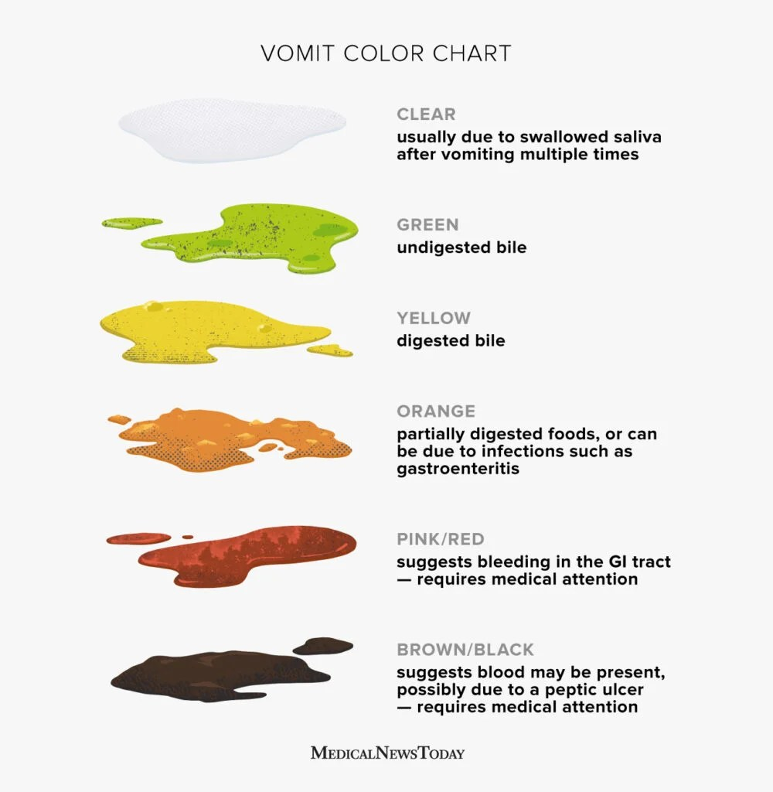


Types of vomit
What does this tell you?
What is the pattern?
Notes:
It is important to establish the type of vomiting as it tells you where digestion occurs.
What is the pattern – ie straight after food, worse in the am, or in the evening,
Is there any warning signs?

Slide 23
Management
Reverse the reversible
Non-drug measures
Pharmacological measures
Notes:
Non drug measures – reducing smells/odours, relaxation techniques, acupuncture, travel sickness bands, dietary advice – small and often.

Slide 24
Plan for Treatment
Specific drug treatment appropriate to cause and receptor involvement
NB use of dopamine antagonists in patients with PD
Use non-oral route if absorption is poor
Rectal preparations
Syringe driver
Notes:
Rectal preparations - domperidone

Slide 25
Management of symptoms
Re-evaluate at regular intervals
-choice of antiemetic
-preferred route
Many need more than one antiemetic, depending on the cause

Slide 26
Other drugs/points to consider
Octreotide
Hyoscine butylbromide
Role of NG tube?
SC Pantoprazole/PPI
Avoid using metoclopramide and cyclizine together
SC syringe pumps can take 4-6 before reaching a therapeutic effect
SC levo has long and short acting properties so can be given 1-2 daily to avoid the need of a CSCI
Notes:
Can use octreotide and HB to reduce gastric secretions.
Pantoprozole can be given SC – made up to 10mls and given over 2 mins. May be indicated for a small number of patients at EOL who have no venous access/unable to swallow to reduce secretions/heartburn.
For chemo induced N&V – consider d/w oncology. Or can refer to local oncology guidelines.
Use of steroids and benzodiazepines.
QTC prolongation.

Slide 27
Latest update on SPCG
Olanzepine 2.5mgs orally nocte for N&V.
Also available as oro-dispersible tab.
Mirtazepine maybe helpful in patients with gastric stasis
Notes:
Olanzepine evidence for chemo related N&V
Use mirtazapine for also appetite and sleep

Slide 28
Summary
Complex, poorly understood pathways
Careful assessment and review
Ensure getting treatment regularly and by appropriate route
Consider underlying causes
Consider non drug measures
Consider side effects of drugs

