Slide 1

What is a good death?
Notes:
Ask the class ‘What is a good death ?’
Lets focus here on the person who is dying
Ask for a few suggestions
Timely assessment and provision of bereavement services
Care which is competent , confident, compassionate and personalised, in line with recognised best practice standards
Joined up co-ordinated services and pathways which are easy to navigate
Access to spiritual and psychological support
Tailored pain management

Slide 2
A good death…
‘Is the best death that can be achieved in the context of an individual's clinical diagnosis and symptoms , as well as the specific social, cultural and spiritual circumstances , taking into consideration patient and carer wishes and professional expertise.’
Ref: NHS England -London End of Life Care Clinical Network
Notes:
It has a Social , historical and cultural context

Slide 3
A good death…
‘..Is defined as a death free from avoidable suffering and distress, consistent with a persons wishes, and in accordance with their spiritual, cultural, and ethical values.’
Ref: ‘AI’
Notes:
It has a Social , historical and cultural context
Personal & individual - dignity / having symptoms controlled , loved ones , familiar setting.
Other key aspexts … maintain control , clear decision making – peace , closure

Slide 4
Group Work
What makes a good or what makes a bad death?
Speculate on what shaped your own personal views and how as nurses this may differ from friends & families.
Reflect upon people living in communities or countries different to yours
Notes:
Give 15 mins for this group work.
Leave slide on the board.
Seek Feedback / Use flip chart to note answers
ASK: Can any death be inherently good?

Slide 5
Dying Matters
Knowing when death is coming & what can be expected
Retaining control of what happens
Dying with dignity & privacy
Having pain & other symptoms managed
Choosing & controlling where death occurs
Having access to information and expertise of whatever kind is necessary
Having access to spiritual and emotional support
Having access to hospice care in any location
Dying when ready and not having life prolonged pointlessly
Having time to say goodbye and control over other aspects of timing
Having a legal document in place to ensure wishes are respected
Ref: Age Concern, 2010
Notes:
Just to tie in with the groupwork …
Here are a list of some of the things that older people said would be important to them if they knew they were dying
It comes from a study asking for thoughts & wishes in relation to death & dying
Ask: lets take a little time to think reflect on these responses. Did we cover these in the group work ?
In the session after lunch we are going to think more about this list and about us as HCP / about our workplaces
Knowing when death is coming & what can be expected…
Predicting the last days or hours is not easy
There can be uncertainty involved in identifying when someone is dying – even when death is expected
Each person is an individual and their experience of dying will be unique to them
Illness or someone's condition can be unpredictable and change can occur suddenly and un-expectantly
Some people may have a sudden change or equally could have a longer period in the dying phase.
Knowing when someone is in the last days & hours is often not easy
It is important to get the views of all involved so that everyone is in agreement that the person is in the last days & hours and death is expected

Slide 6
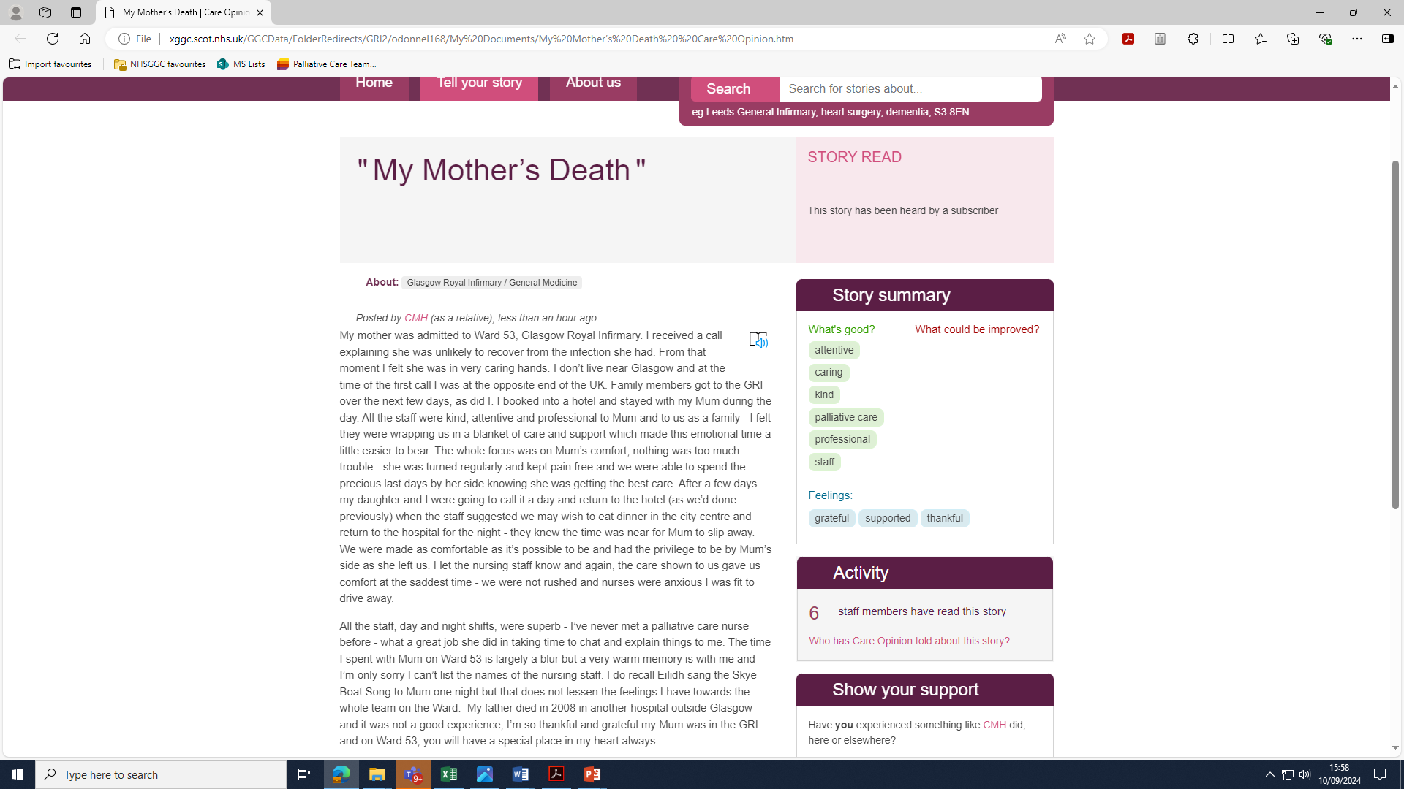
Notes:
This slide is not made up but is a care opinion of care around death by a daughter when her mother was dying in this hospital.
This details for a daughter what a good death was and looked like
Ask: How does this make you feel?

Slide 7
A good death …
Awareness & acceptance of dying
Preparedness
Comfort
Closure
Peacefulness and dignity
Presence of family and being in familiar like setting
Personhood
Timeliness
Ref: Bogstram 2014 & Cottral & Duggleby 2016
Notes:
To help summarise all we have chatted around re: A good death – here is a slide with some features that have become synonymous with ideas surrounding ‘a good death’ in contemporary western societies.
Awareness & acceptance of dying ( viewed as positive)
Preparedness ( getting ones affairs in order)
Comfort ( minimising pain & symptoms)
Closure ( addressing and resolving difficult issues)
Peacefulness and dignity
Presence of family and being in familiar ,ike setting
Personhood ( a sense that an individuals wishes and preferences have been accounted for)
Timeliness ( dying at an older age , and dying process predictable , identifiable start and endpoint)
Central to all of these is having control over dying …
Ask : How many of these as nurses can we influence ?
Sensitivity and dignity to support a good death
Time for HCP to work with individual , other HCPs and fam & friends to ensure needs of individual met fully as possible – enabling them to remain in control and involved in own care at eol.
Effect communication is very important during this care as hcp need to convey information in a way that everybody understands
Embrace different perspectives
Recognise importance of policies that support practice

Slide 8
'Dying isn't as bad as you think' Kathryn Mannix
Notes:
We are now going to play a short video ….
'Dying is not as bad as you think' | BBC Ideas (youtube.com)
Kathyn Mannix , Retired Palliative Care Consultant and Author.
She has made it her mission to talk about death and dying , encouraging people to have
Meaningful conversations about last wishes and love before it is too late …
Ask : What stood out for you ?

Slide 9
