Slide 1
Palliative Care
Emergencies
Louise Hagerty
ST6 palliative medicine

Slide 2
Learning outcomes
Appreciate that emergencies happen in palliative care
Understand role in recognising these and considering appropriateness of treatment
The ‘big 5’ palliative care emergencies
Other emergency considerations

Slide 3
Palliative care… emergency?
= a situation if left unmanaged that will seriously threaten the quality of life remaining
Palliative Care Emergency
Oncological Emergency
Spiritual, Existential or Social Crisis
Rapid Discharge
Don’t forget other acute conditions still arise in patients with palliative care needs!

Slide 4
What decisions need to be made?
Prompt diagnosis +/- treatment – can alter outcome
Missed treatment of reversible symptoms can be disastrous for quality of life remaining
Avoidance of inappropriate treatment – still needs management plan
  What are the wishes of the patient / carer?
    Preferred place of care / death
    Thoughts about life-prolonging treatment
  Physical condition of the patient / Stage of disease / Prognosis
  Balancing effectiveness vs toxicity of treatment
  Providing an alternative robust management plan and support

Slide 5

Case 1
48 year old man with a BG of metastatic penile cancer and a large fungating wound in his groin with tumour invading his femoral artery
There are no further plans for oncology treatment
He has had a few small bleeds in the groin
He has 2 young children – aged 5 and 7
His preferred place of care is home
What concerns do you have?
How would you approach this situation?
What would you consider as part of the management plan here?

Slide 6
Terminal Haemorrhage
Rare, but very frightening
Causes / risk factors
  Type of tumour
  Fungating tumour - invasion of major artery
  Treatments – steroids / NSAIDs / radiotherapy
  Infection
  Cachexia / frailty
  Sentinel bleeds
To tell or not to tell?

Slide 7
To tell or not to tell?
Catastrophic Bleeds feared but rarely occur
No preparation doesn’t make it any less frightening
Can anything to done to reduce the risk - ? Embolisation
Special circumstances – children in house, may be especially traumatised
Warning bleed – increased chance of major bleed
What does the patient/family want to know
Can be a barrier to going home

Slide 8
Terminal Haemorrhage
Management – preparation
  FCP discussions esp if sentinel bleeds
  Explain rare event
  Have emergency medications prescribed
  Easy access to dark towels
  ?prevention – radiotherapy / TXA
Management – in the event of a bleed
  STAY with the patient – counsel on this
  Apply gentle pressure if appropriate
  Prompt use of medications:
    10mg IM midazolam – can be repeated after 10 mins if patient still distressed
    Analgesia if required

Slide 9
‘Non-terminal’ Bleeding
‘Physical measures:
  Gauze soaked in tranexamic acid or adrenaline (1 in 1000) and pressure applied for 10mins
  Silver nitrate sticks applied to bleeding points in nose / mouth / skin nodules
  Haemostatic dressings e.g. alginate
  Specialist input – consider RTx / embolization / coagulation with cryo or laser
Topical / Systemic: Tranexamic acid
  On gauze / mouthwash or gargle
  Oral / PEG – 1-2g TDS – discontinue 1 week after cessation of bleeding or reduce to 500mg TDS (if bleeding recurs – continue at higher dose indefinitely) **caution in renal failure – dose reduction**
  CSCI
Haematuria
  Consider up to daily catheter irrigation
  Can use TXA but caution – increased risk of clot retention

Slide 10
Case 2
72 year old lady with metastatic breast cancer to liver and bone
Presents with vomiting
Collateral history from husband – she has been muddled over the past 4 days
Constipated for several days
O/E – confused, dehydrated
Any other information you would like?
What could be going on?
What would you consider as part of the management plan here?

Slide 11
Hypercalcaemia
Occurs in 40% of patients with cancer
  Commonly in breast, lung, renal, head & neck, lymphoma and myeloma
  Bone mets common but not always present (20% do not have bone mets)
  80% of patients die within 1 year – poor prognostic sign

Slide 12


Hypercalcaemia
Symptoms
Management
Constipation
Nausea & vomiting
Bone pain
Thirst & polyuria
Confusion
Hallucinations
Rehydrate – IV fluids*
1st line: Bisphosphonate – ‘zometa’ (can take up to 5 days to work)
2nd line: Denosumab SC
Consider place of care
  Hospital
  Hospice (incl. interventional clinic)
  Hospital @ Home
If imminently approaching EOL ?manage symptoms only
Often rate of increase
rather than absolute value
Notes:
IV fluids – 2-3L/day
Bisphosphonate – takes a few days to work
May mimic the dying phase but also a sign of poor prognosis so patient may be dying
Median prognosis is 3 months
If calcium resistant to treatment – prognosis may be days to weeks

Slide 13
Case 3
You are requested to do a house visit to a 68 year old man with a BG of prostate cancer currently on hormonal treatment
He is an ex-plumber and has a history of chronic back pain, which limits him from leaving the house independently
Normal bone scan 6 months ago
C/O severe back pain in the past week
  ‘it’s like the back pain I’ve had for years acting up again but worse and my walking has been a bit slow over the past few days’
  ‘Co-codamol is taking the edge off it’
What else might you want to ask / do?
How would you manage this patient?

Slide 14
Malignant Spinal Cord Compression (MSCC)
Occurs in 5% of patients with cancer
  Highest risk: multiple myeloma / prostate / breast / lung cancer
High index of suspicion is vital
Signs can be very subtle
Levels – thoracic (70%), lumbosacral (20%), cervical (10%)
Consequences of delay in diagnosis can be very detrimental to quality of life
  70% of patients who remain ambulant at the start of their treatment RETAIN their ability to walk
  Only 5% of patients paraplegic at the start of their treatment regain their ability to walk
  Life expectancy in those who remain paraplegic is often measured in weeks to short months

Slide 15
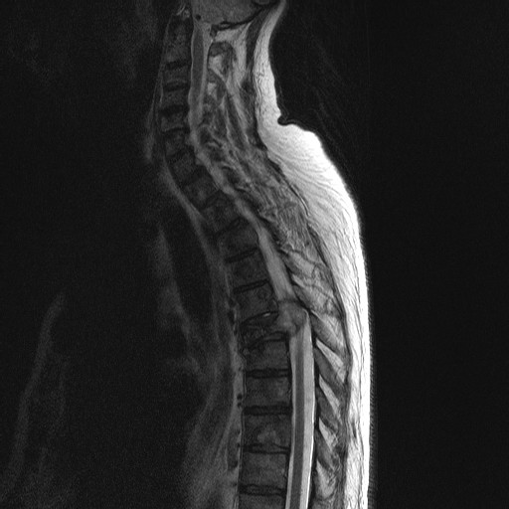

Slide 16
Malignant Spinal Cord Compression
Symptoms
In reality…
Back pain ‘tight band’
Weakness
Difficulty walking
Sensory disturbance
Bladder or bowel dysfunction
Saddle area paraesthesiae
Mixed picture or subtle neuro signs
Often if signs ‘classical’ – too late
Any patient with back pain and subtle neurology consider MRI
In general pain precedes any weakness or sensory disturbance
Notes:
IV fluids – 2-3L/day
Bisphosphonate – takes a few days to work
May mimic the dying phase but also a sign of poor prognosis so patient may be dying
Median prognosis is 3 months
If calcium resistant to treatment – prognosis may be days to weeks

Slide 17
Malignant Spinal Cord Compression (MSCC)
Management:
Initial:
Commence high dose steroids – Dexamethasone 16mg initially then 8mg BD
Arrange urgent MRI if appropriate
D/W oncology team
To be considered:
Radiotherapy – if radiosensitive tumour, if there are multiple levels of SCC
  Good at reducing pain, but not regaining power
Surgery – not as common, consider if spinal instability or first presentation and no tissue diagnosis
Chemotherapy – adjuvant treatment for responsive tumours
MDT input essential:
PT & OT assessment
Skin management
Bowel and bladder management
Psychological support
Pain control

Slide 18
Seizures
Occurs in 10-15% patients with palliative care needs but 70% patients with brain tumours.
Assessment:
Check for other causes – missed medication doses / vasovagal / postural ↓BP / hypoglycaemia
Primary or secondary brain tumours / cerebrovascular disease / epilepsy/ biochemical abnormalities
Have an anticipatory care plan – can be distressing

Slide 19
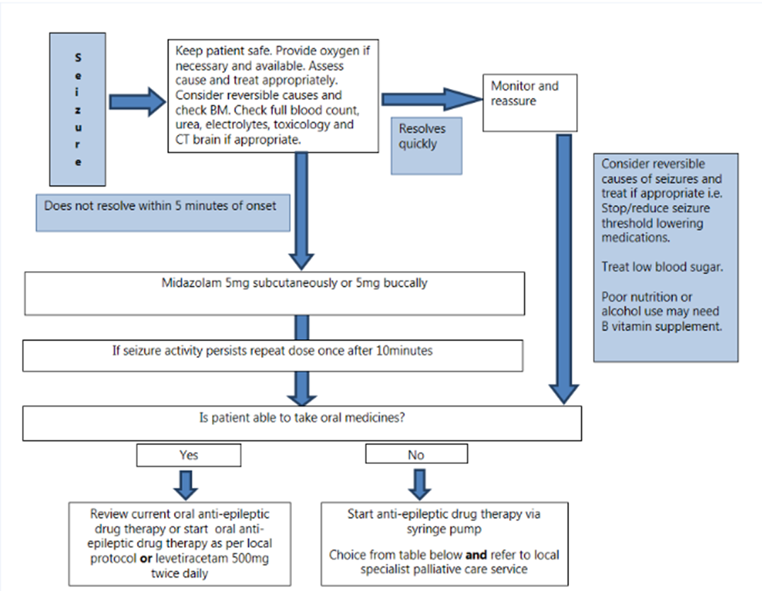

Slide 20
Treatment
Start anti-seizure medication after a seizure as risk of recurrence is high
1st line – levetiracetam
Consider dexamethasone
Need to consider patient needs/route/prognosis
If end of life consider CSCI midazolam –20-30mg dose for seizure control
Other measures –
  CSCI levetiracetam
  Under specialist guidance – phenobarbital and propofol

Slide 21
Case 4
A 80 year old man care home resident has been getting increasingly SOB for 1 week. He has a BG of squamous cell carcinoma of the right lung
He has been on steroids for 3 weeks for wheeze and his family have noticed his face is more swollen. He also suffers from headaches which are new and he has some distended chest veins
What may be going on?
How would we manage this problem?

Slide 22
SVCO
Investigation
  CT scan
Management:
  Steroids – dexamethasone 16mg stat → 8mg BD thereafter
  Oncology referral – consideration of SACT and radiotherapy for SCLC
  Endovascular stenting via IR if appropriate – confers quickest control of symptoms
  Supportive treatment – oxygen / opioids

Slide 23
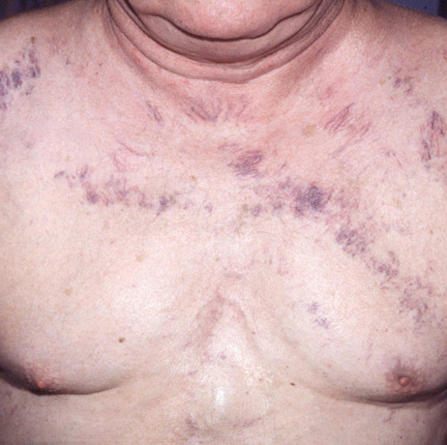
Superior Vena Cava Obstruction
Obstruction to the SVC blood flow by:
  External compression by mediastinal nodes / tumour
  Thrombosis
  Direct invasion of SVC
  Combination
Causes:
  Lung carcinoma (65-80%)
  Lymphoma (2-10%)
Can be presenting sign of cancer
Histology can be important for treatment option

Slide 24
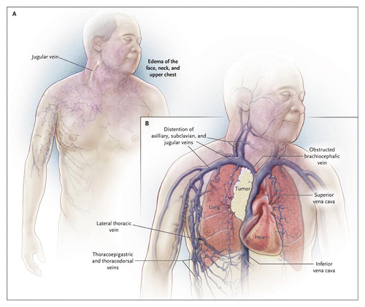

Slide 25
SVCO
Symptoms
Breathlessness
Headache
Visual disturbance
Light-headedness / syncope
Signs
Neck and facial swelling / periorbital oedema
Injected conjunctivae
Non-pulsatile distension of neck veins
Cyanosis
Dilated collateral superficial veins on the chest
Stridor

Slide 26
Other emergency considerations in palliative care
Psychological / social / spiritual crisis
Rapid discharge
Uncontrolled severe symptoms – breathlessness / pain
Terminal agitation

Slide 27
Summary
Palliative emergencies are acute events that need to be treated as an emergency, reviewed promptly with appropriate decision-making in line with patient’s wishes
Regardless of whether it is treatable – symptoms should be managed urgently
Have high index of suspicion and advocate for your patient if you feel something is not right
Help is nearby - Hospital palliative care liaison team / OOH on call palliative care doctor / Oncology / SPCG very useful!

Slide 28
Any (easy) questions?
louise.hagerty3@nhs.scot

Slide 29
References
Breathlessness intervention service (BIShttps://www.cuh.nhs.uk/our-services/breathlessness-intervention-service/) | CUH
Right Decisions: SPCG
PCF Version 8

