Slide 1

Palliative Care for Individuals with Substance Use Disorder
Dr Lucy Hetherington
Consultant Palliative Medicine
Greater Glasgow and Clyde
May 2025
lucy.hetherington@nhs.scot
Notes:
Not going to cover smoking and alcohol

Slide 2

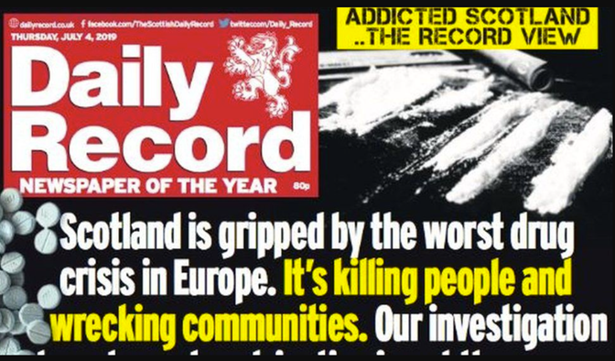
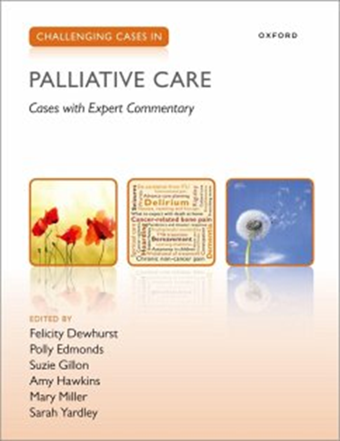
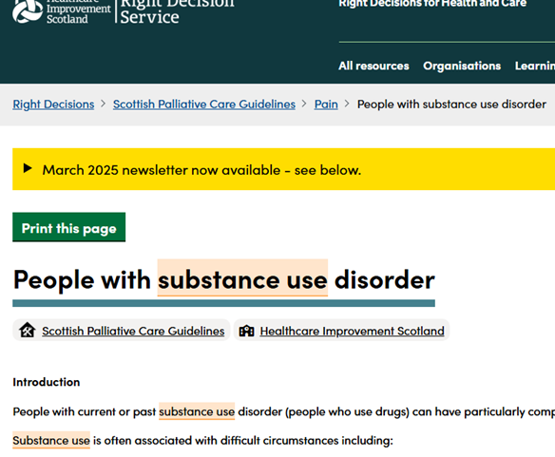
Experience
2020/2021 Scottish Clinical Leadership Fellow, Drugs Policy, Scottish Government.
Author, Scottish Palliative Care Guidelines, Individuals with substance use disorder 2022 & 2025
Chapter Author Pain in people with Substance use disorder, Challenging Cases in Palliative Oxford University Press in May 2024.
Notes:
Explore barriers to a coordinated health and social care response to those experiencing multiple and complex needs (MCN)
Drugs Death Task Force (DDTF)
DDTF – MCN group funding bids review – 2.5million
Set up a cross government MCN networking group
Liaison with those with lived experience
SLWG to explore reasons for a disproportionate increase in drug related deaths in women and the subsequent implications for policy and practice.
Input into - unscheduled care, distress brief intervention, Inclusive Scotland, HIS, Trauma informed care, mental health assessment units, vaccine delivery
Developed accepted terminology guidance for SG.
Guidelines - Linda Johnston, Susan Cook.

Slide 3

Intended Learning Outcomes
Use respectful, person-first language
Describe recent drug use trends
Understand the challenges and inequalities faced
Consider ways of providing better care
Discuss some management options
Know where to get further help and support

Slide 4
But first…. Lets talk about language
The language used can seem complicated and often changes over time
Previous terms were thought to be stigmatising
We should try to avoid using words that risk increasing shame or suggest blame

Slide 5

Please Avoid | Please Try to Use | Why?
Drug user | Person who uses drugs (PWUD) | Use person first language
Addict Drug/substance abuser Junkie | Person with drug dependence Person with problematic drug use Person with substance use disorder Person who uses drugs | The person “has” a problem, rather than “is” the problem.
Addiction | Drug dependency ? Drug problem ? Problem substance use | Disputed and ranging definitions of what ‘addiction’ means
Illicit Drug Abuse Prescription Drug Abuse | For illicit drugs: Use For prescription drugs: Misuse Use other than prescribed Non-prescribed use | Abuse has negative connotations Consumption outside prescribed use is misuse

Slide 6



Terminology
Addiction Teams
Maintenance Therapy
Substance use Services (SUS)
Drug and Alcohol Recovery Services (ARDS)
Medication Assisted Treatment (MAT)

Slide 7
Background - Scotland
High levels of problematic drug and alcohol use compared to the rest of the UK
Problematic use double that in England
Alcohol misuse is a significant problem
Notes:
So why am I here today? Well we know that Scotland continues to have high levels of drug and alcohol misuse, in fact levels of problematic use are double that of England. And whilst alcohol misuse is a bigger problem for. Scotland, today I will focus on soley drug misuse

Slide 8

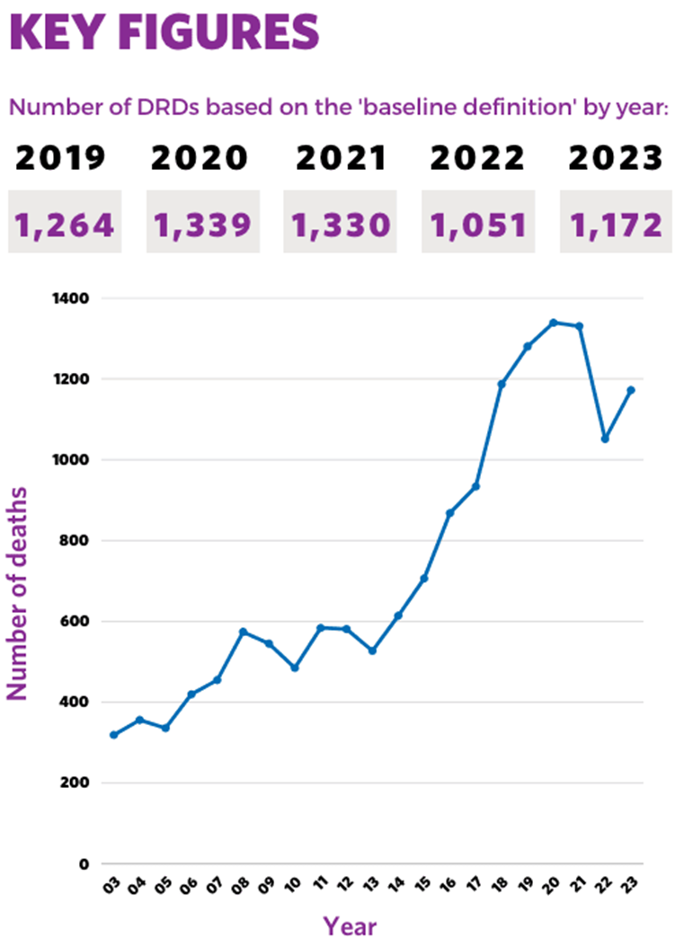
Drug Related Deaths
Scotland has the highest drug death rate recorded by any country in Europe.
Rate is more than 3.5 times that of England and Wales.
Notes:
The number of drug-related deaths has increased substantially over the past 20 years and is now almost three times higher than it was a decade ago, with the upward trend accelerating since 2013.

Slide 9

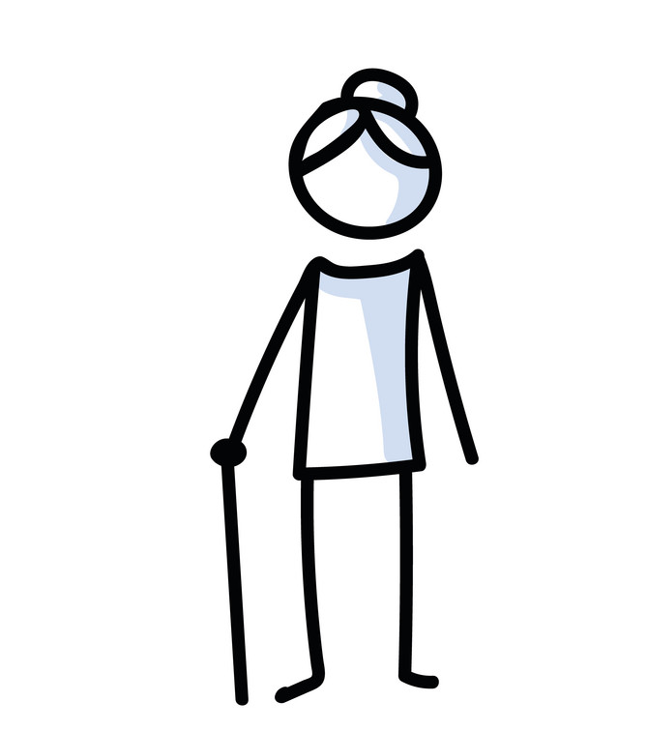

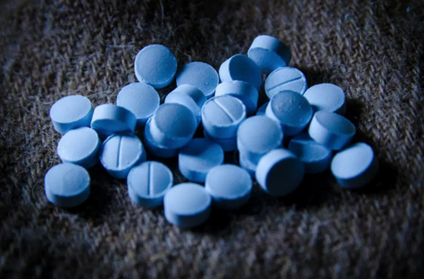
bACKGROUND
Males predominate across all the Scottish Health Boards and all the age ranges.
The age of people using drugs in the UK continues to trend upwards such that 56% of people in treatment are over 40-years-old.
WoS accounts for 60% of drug use in Scotland, but only 49% of population.
Polydrug use is increasing, especially benzodiazepine use.
Notes:
What else do we know about his group? Well compared to the general public, those that frequently use drugs are more likely to live in deprived areas and be economically inactive
We knowin Scotland that across all. HBs, males predominate and the WOS accounts for the majority of this group
Sarangi A, McMahon T, Gude J. Benzodiazepine Misuse: An Epidemic Within a Pandemic. Cureus. 2021 Jun 21;13(6):e15816. doi: 10.7759/cureus.15816. PMID: 34306882; PMCID: PMC8294026.
Over recent years there has been an increase in polydrug use, especially benzodiazepine co-use.4 Benzodiazepines may potentiate the effects of prescribed and non-prescribed substances, increasing the risk of respiratory depression when taken alongside opioids, particularly in older people. Patients may experience withdrawal from benzodiazepines on admission to hospital.

Slide 10

Background – Multiple Complex Needs
Many people in Scotland struggle with complex life challenges.
Driven by a history of:
poverty
childhood adversity
trauma
These challenges include:
deteriorating physical and mental health
poor housing or homelessness
contact with the criminal justice system
substance misuse
gender based violence
Notes:
Severe multiple disadvantage
2019 report – LanKelly Chase - Hard Edges Scohttps://lankellychase.org.uk/publication/hard-edges-scotland/tland full report – Lankelly Chase

Slide 11
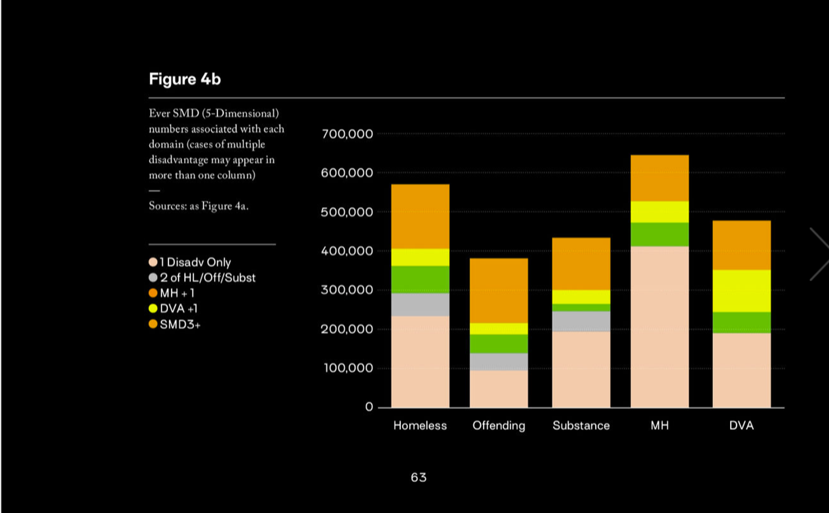
Hard Edges Scohttps://lankellychase.org.uk/publication/hard-edges-scotland/tland full report – Lankelly Chase
Notes:
The June 2019 Hard Edges Scotland report presented the issues compellingly. Highlighting the need for a coordinated public sector response to provide better support to people, their families and children who experience severe, multiple disadvantage (SMD).

Slide 12
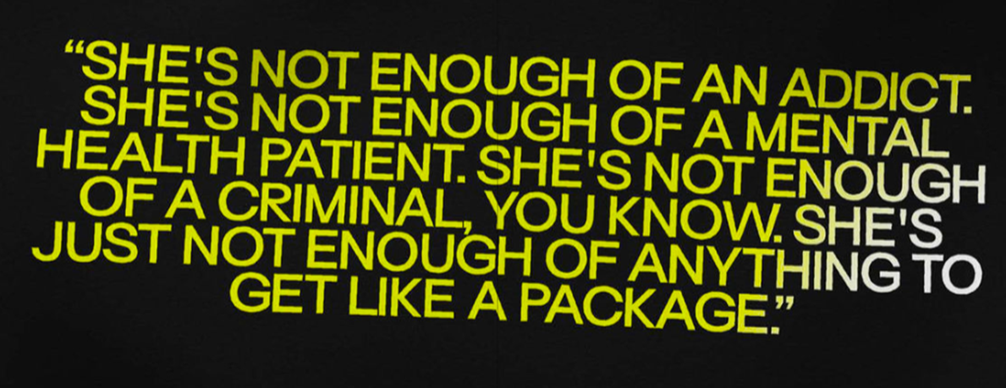
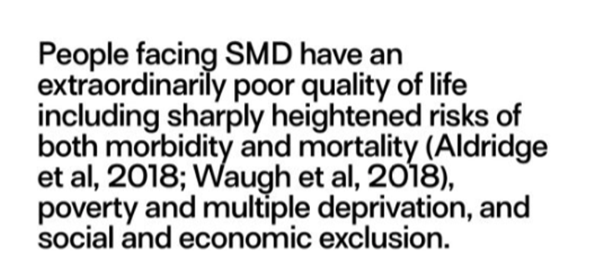

Slide 13
Multiple Complex needs
This population:
primarily live in deprived areas
live on the edge of potential crisis.
Too often, we fail them:
very poor quality of life
intergenerational damage
poor outcomes are passed on to families and children.
Health and social care services are designed to meet single problems and fail to encompass these complex needs.

Slide 14
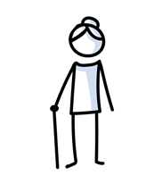

Why Palliative care
This growing, ageing cohort are at increased risk of developing life limiting illness, both drug and non-drug related.
Substance use may lead to an earlier age of death and a greater burden of disease and ill health.
77% of deaths in PWUD aged >40yrs were NOT drug deaths.
Liver diseases (15.3%), cancer (13.1%), chronic lower respiratory infections (8.3%) and viral hepatitis (6.1%) are common causes of death.
Higher incidence of cancer compared to average population (lung, liver, lymphoma).
Notes:
Older and sicker: Changing mortality of drug users in treatment in the North West of England C. Beynon et al. / International Journal of Drug Policy 21 (2010) 429–431

Slide 15

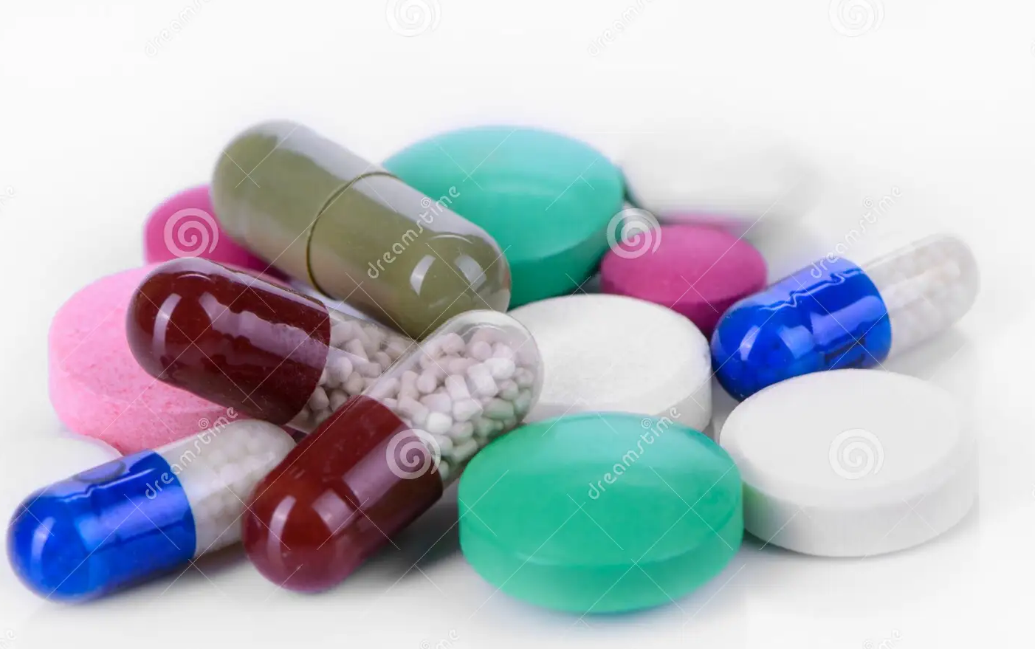

Why Palliative care
Distrust, fear of stigma and fear of inappropriate management of their drug dependence, can result in healthcare avoidance and delayed presentation.
Pharmacology of symptom control can be complex, challenging social circumstances are common, and providing continuity of care can be difficult.
It is vital that these patients are offered compassionate, coordinated, trauma-informed, non-judgmental care

Slide 16
So what does this mean?
Growing population of aging patients with ongoing or past substance use disorder
Who have an increased risk of developing life limiting illness

Slide 17
Often Coupled with
High levels of deprivation
Challenging / complex daily routines
Social isolation / estranged from family and friends

Slide 18
Often Coupled with
Struggle to access Health Care Services
Late presentation of disease
Mental Health Issues
Homelessness

Slide 19
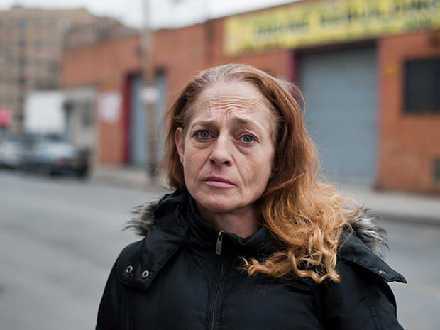
A Case – Lydia, 49F
Admitted to hospital having been found unresponsive at home.
6/12 history of:
weight loss
increasing breathlessness
back pain.
Investigations revealed a new diagnosis of lung cancer with pulmonary, nodal and bone metastases.

Slide 20



Lydia - Background
The admitting team suspected use of non-prescribed substances.
They were concerned about prescribing methadone and analgesia.
Lydia was referred to the hospital palliative care (HPCT) for assistance with symptom control.
Hx of opioid dependence – IV heroin
Methadone MAT, 50mg daily, dispensed weekly.
Good rapport with her substance use services (SUS) key worker but had declined medical review.
PMHx:
COPD, anxiety and depression.

Slide 21
Lydia - HPCT
Complex situation early review
Reassurance:
Joint working with SUS
symptom control
ongoing methadone MAT
Rapport
Lydia confided:
Street benzodiazepine in addition to methadone - helpful for her pain.
Occasional use of partners methadone when in severe pain.
Heroin use had crossed her mind from time to time when pain was particularly troublesome.
Notes:
The HPCT recognised the complex situation and arranged early review.
They offered Lydia reassurance that they would work jointly with SUS to prescribe appropriate medication for symptom control, alongside ongoing use of methadone MAT.
Spent time building a rapport.
Lydia confided that she used street benzodiazepine in addition to methadone.
She found it helpful for her pain.
Lydia reported occasionally taking some of her partners methadone when in severe pain. Heroin use had crossed her mind from time to time when pain was particularly troublesome.

Slide 22
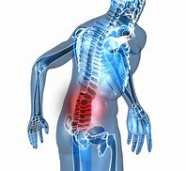
Lydia symptoms
Lumbar spinal pain, radiation around her flanks
Neurological examination was normal
Shortness of breath on exertion
Constipation
Anxiety re hospital & diagnosis
Worried she may withdraw from benzos
Minimal social support

Slide 23
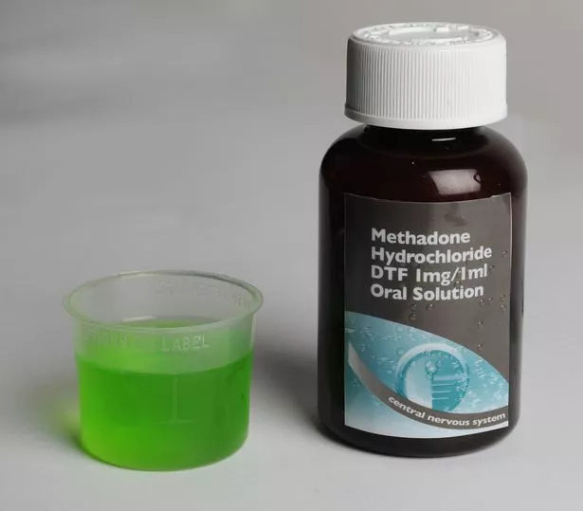
Lydia - management
Discussion with SUS
Methadone MAT was continued at Lydia’s normal dose
Morphine sulphate MR 20mg BD
Morphine sulphate IR 7mg PO PRN
Diazepam 2mg QDS
Laxatives

Slide 24
Lydia - Management
Morphine MR titrated.
MRI spine confirmed lumbar metastases and ruled out cord compression.
MDT:
Oncology follow-up, consider XRT and SACT.
Lydia’s goals:
Improved pain control
Time with daughter (20F).
Time in recently secured her own flat.
Notes:
Previously in hostels/homeless

Slide 25
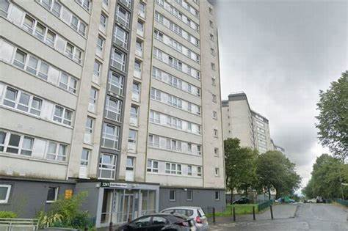
Lydia - Discharge
Discharged home
Community palliative care follow-up.
Lydia’s case was discussed directly with:
GP
Pharmacy
SUS
Discussions around the safe provision of controlled drugs

Slide 26
Lydia - community
Initially……… met community team and oncology OPC.
Later…….. stopped responding to phone calls and DNA’s.
4 weeks later:
Readmitted to hospital ‘off legs’
PS 3-4, weight loss, lower back pain with radiation down her legs
Partner left
Contact with old friends
Heroin use - provided an escape from the ‘hopelessness’ she was experiencing
PS 3-4, weight loss, lower back pain with radiation down her legs
Notes:
After hearing of Lydia’s diagnosis, her partner left, and friends who were actively using drugs became involved in her life again. Medication ‘lost’
Lydia restarted using heroin, feeling it provided an escape from the ‘hopelessness’ she was experiencing. At the point of readmission, she had a declining performance status, further weight loss and lower back pain with radiation down her legs.

Slide 27
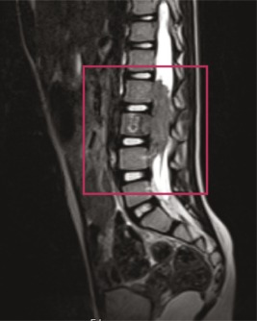
Lydia - Readmission
MRI scan confirmed spinal cord compression
XRT
Not for SACT
HPCT:
Worked with SUS to re-establish methadone MAT.
Manage her symptoms of pain and anxiety.
Gabapentin was added for neuropathic pain.

Slide 28

Lydia – ONGOING CARE
Mobility limited to transferring with assistance
No rehab potential
Safety of CDs, JIC meds
No family support
Appropriate place of care?
Notes:
Vulnerable at home concerned that people may try to break into her flat to steal her medication.

Slide 29
Lydia
Two CSCIs were commenced:
morphine and midazolam
methadone at 50% of her oral dose
Titrated Morphine and midazolam
Levomepromazine added
Hopice IPU for Sx control
Deteriorating condition
‘Short weeks’
Notes:
On two occasions staff expressed concern that friends may have brought non-prescribed substances to the hospice as Lydia had been particularly sleepy after their visit. This was escalated, hospice policy and the legal standpoint clearly discussed, and the possible risk to the patient explained.
The morphine and midazolam were titrated as required. Lydia later experienced terminal agitation requiring escalation of midazolam and the addition of levomepromazine. She died in the hospice with her daughter present as per her wish.

Slide 30
Its not easy!

Slide 31
Maybe its not as difficult as we think?

Slide 32
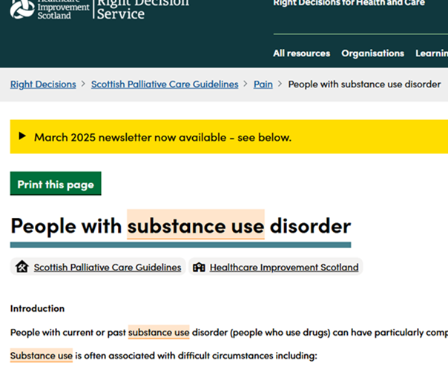
https://rightdecisions.scot.nhs.uk/scottish-palliative-care-guidelines/pain/people-with-substance-use-disorder/?searchTerm=substance%20use

Slide 33
Where to Start?
As far as is possible, do what we always do.
Notes:
Take a drug history: by that I mean ask them if they are using anything to help with the pain
I think we should try to stick to the way we would normally manage symtpoms as best we can and as much as patients concur

Slide 34
Where to Start?
Manage what is manageable
Communicate to everyone involved
Ask about their current drug use
Notes:
Take a drug history: by that I mean ask them if they are using anything to help with the pain
I haven’t done a case because I think we should try to stick to the way we would normally manage symtpoms as best we can and as much as patients concur

Slide 35
Talking about Drugs
Just ask what they are taking.
Sometimes I say:
‘”I can tell that the pain has been really bad by what you have told me… have you had to use any non-prescribed drugs to help with this?”
Ask the patient to clarify if you are unfamiliar with the street names used.
Notes:
Recovery services ‘ give a decent dose of MAT…. I tend to think similiarly int ermos of pain management

Slide 36
Substance Use Service
They will often know the patient best
Ask SUS to review jointly
Consider a discussion with patient and SUS about stabilising any MAT and not pursuing further reduction
Their assessments are remarkably similar to ours.
They can help if dispense daily/ weekly prescription needs changed or someone else now needs to collect
Notes:
Take a drug history: by that I mean ask them if they are using anything to help with the pain
I haven’t done a case because I think we should try to stick to the way we would normally manage symtpoms as best we can and as much as patients concur

Slide 37

Recognise your own judgements, worries and fears.

Slide 38
Pain Management: My Experiences
“Pain is what the patient says it is”….. Unless you have a substance use disorder
And then it is thought to be drug seeking behaviour.
It might be.
But it might be uncontrolled pain?
Notes:
Recovery services ‘ give a decent dose of MAT…. I tend to think similiarly int ermos of pain management

Slide 39
Pain Management: My Experiences
Doctors reluctant to prescribe
Nursing staff reluctant to administer
Patient can be reluctant to have if now in recovery
Notes:
Recovery services ‘ give a decent dose of MAT…. I tend to think similiarly int ermos of pain management

Slide 40
Sometimes:
Doctor anxiety about drug seeking behaviour
Patient seeks illicit analgesia to help pain
Uncontrolled pain
Under prescribing
Notes:
At risk of crisis/ terminal haemorrhage: was this addressed in ACP

Slide 41
Perhaps ?
Doctor prescribes appropriately
Reduce one of the drivers towards illicit drug use
Pain manageable
Notes:
At risk of crisis/ terminal haemorrhage: was this addressed in ACP

Slide 42
Analgesia
Opioids should be started and titrated as they normally would for symptom control.
In some circumstances larger opioid doses may be required but the degree of tolerance an individual has is variable and difficult to predict.
Unless clear reasons not to, oral modified release preparation is the first line choice.
Patches do not prevent abuse.
Notes:
Some patients taking MAT may be reluctant to take opioids. Clear information needs to be given regarding the purpose of opioids for analgesia rather than recreational use.

Slide 43
Breakthrough Analgesia
May be best kept to a minimum, with titration of the background opioid preferred.
Patient may not want it.
If limiting this, ensure frequent clinical review.

Slide 44
Breakthrough Analgesia
The MAT dose should not routinely be used when calculating the appropriate breakthrough dose for symptom control.
Multiple breakthrough doses may represent inappropriate use or it could be undertreated pain.

Slide 45
Adjuvant Analgesia
Non-opioid analgesics should be considered as adjuvants when appropriate, but not as substitutes for strong opioids.
There is potential for misuse of adjuvants, especially Gabapentin and Pregabalin.
Consider Amitriptyline first line if there is particular concern.
Consider non-drug options.
Notes:
Some patients taking MAT may be reluctant to take opioids. Clear information needs to be given regarding the purpose of opioids for analgesia rather than recreational use.
Non-drug options inc heat packs, XRT, nerve blocks etc

Slide 46
Methadone MAT
MAT should continue and should not routinely be titrated for symptom control.
Treat the MAT as a separate prescription that is not involved in symptom management or breakthrough dose calculation.
Discuss stabilising the Methadone MAT dose without further reduction with patient and SUS
Notes:
Some patients taking MAT may be reluctant to take opioids. Clear information needs to be given regarding the purpose of opioids for analgesia rather than recreational use.

Slide 47
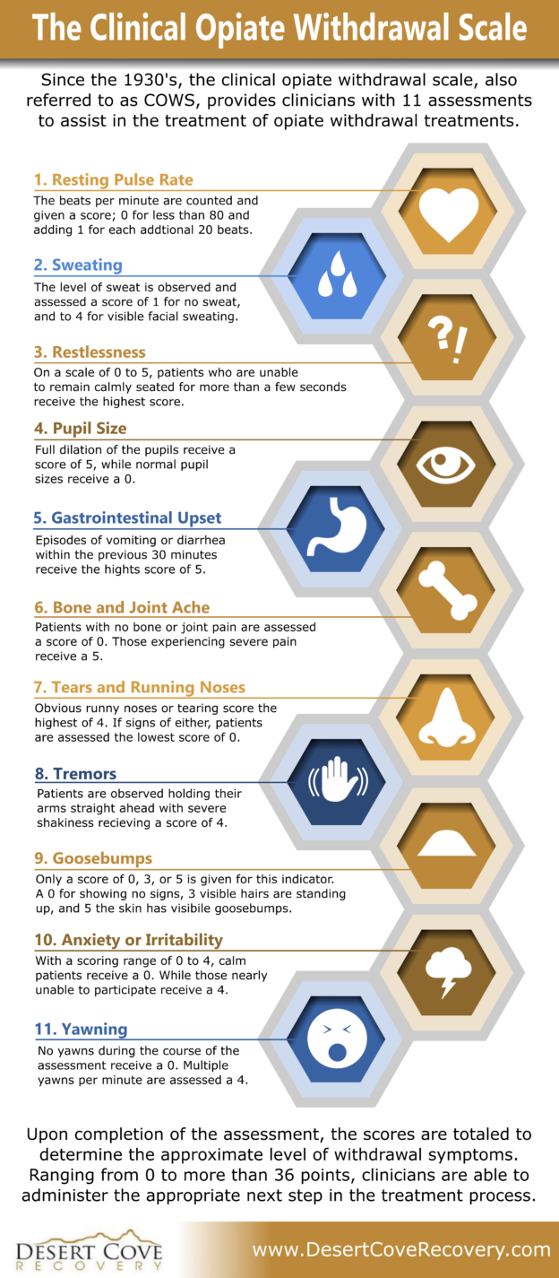
Opioid Withdrawal Not uncommon and can go unrecognised. Give some immediate release opioid. If 3 or more doses of Methadone MAT have been missed, contact SUS for advice on how to restart - may need a lower restart dose. ** BENZO WITHDRAWAL **
Notes:
benzodiazepine withdrawal is characterized by sleep disturbance, irritability, increased tension and anxiety, depression, panic attacks, hand tremor, shaking, sweating, difficulty with concentration, confusion and cognitive difficulty, memory problems, dry mouth, nausea and vomiting, diarrhea, loss of appetite and weight loss, burning sensations and pain in the upper spine, palpitations, headache, nightmares, tinnitus, muscular pain and stiffness, and a host of perceptual changes.^{[2]} More serious symptoms may also occur such as depersonalization, restless legs syndrome, seizures, and suicidal ideation.

Slide 48
Methadone MAT at End of Life
Convert to a CSCI at 50% of the daily oral dose
Diluted in 0.9% Saline
Administer in a CSCI without any other drugs.
Occasionally a CSCI may not be appropriate, in which case, Methadone MAT can be administered at 50% of the daily oral dose, split into twice daily subcutaneous bolus injections .
Notes:
Some patients taking MAT may be reluctant to take opioids. Clear information needs to be given regarding the purpose of opioids for analgesia rather than recreational use.

Slide 49
Buprenorphine MAT
Typically used at higher doses than in the palliative care setting which can result in antagonism when other opioids are required.
Anecdotally antagonism could occur with daily doses of 8mg or more.
There is increasing use of long-acting subcutaneous Buprenorphine preparations for MAT such as Buvidal® which last for up to 4 weeks.
Notes:
Some patients taking MAT may be reluctant to take opioids. Clear information needs to be given regarding the purpose of opioids for analgesia rather than recreational use.

Slide 50
BuprenorphineMAT
Consider a switch from Buprenorphine MAT to Methadone MAT guided by SUS if antagonism is a concern.
Consider use of Opioids with a high mu-opioid receptor affinity (Fentanyl and Alfentanil).
Notes:
Some patients taking MAT may be reluctant to take opioids. Clear information needs to be given regarding the purpose of opioids for analgesia rather than recreational use.

Slide 51
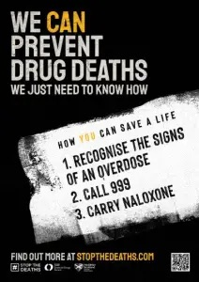
At Home Naloxone Be mindful of Naloxone at home Is this still appropriate? Individuals and carers may require education around this.
Notes:
At risk of crisis/ terminal haemorrhage: was this addressed in ACP

Slide 52
Families & Friends
Can be isolated from the usual sources of support.
They may be less able to talk to others because of stigma, shame, embarrassment, self-blame..

Slide 53
Families & Friends
Sometimes they are still estranged from the patient, but not through their choosing.
May also have substance use disorder
Or the relationship can be fractious or confrontational

Slide 54
Families & Friends
May have more complex bereavement and require more specialist support.
Families may not want substance use recording on the death certificate
Funeral Poverty

Slide 55
Summary
Funeral Poverty
We already have the skills needed to help care for these patients.
Try to manage symptoms as we would in our normal practice.
Treat holistically, using a trauma informed approach
Be as flexible as possible
https://www.traumatransformation.scot
Notes:
Be as flexible as possible, meeting at a time and place that is suitable for them – avoid ‘didn’t engage

Slide 56
Summary
Funeral Poverty
Work collaboratively
Try not to make assumptions
Notes:
Full multidisciplinary involvement, case conference or both may be of value.

Slide 57
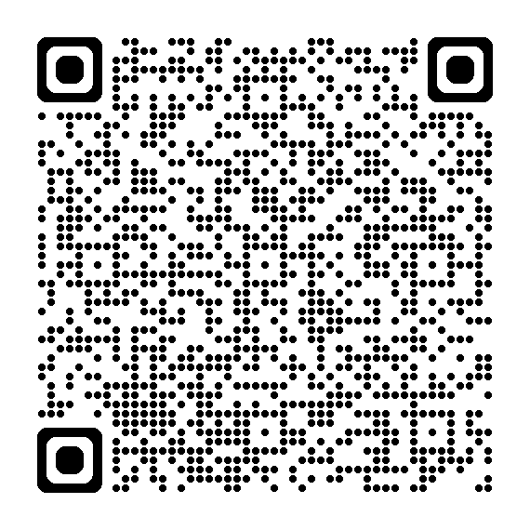
Summary
Scottish Palliative Care Guideline:
‘Palliative Care for People with Substance Use Disorder’
https://rightdecisions.scot.nhs.uk/scottish-palliative-care-guidelines/pain/people-with-substance-use-disorder/?searchTerm=substance%20use

Slide 58
References
https://rightdecisions.scot.nhs.uk/scottish-palliative-care-guidelines/pain/people-with-substance-use-disorder/?searchTerm=substance%20use
Galvani S, Wright S, Witham G. Good practice guidance: Supporting people with substance problems at the end of life 2019 [2022 Apr 14] https://endoflifecaresubstanceuse.com
Marie Curie Scotland & Dr Joy Rafferty: Dying in the Cold; Being Homeless at the End of Life in Scotland
NIHR - Substance use and serious & advancing ill health Essential information for social and health care professionals https://endoflifecaresubstanceuse.com
Palliative Drugs.com Guidelines for Cancer Pain Management in Substance Misusers Dr Jane Neerkin, Dr Chi-Chi Cheung and Dr Caroline Stirling
Drug and Alcohol Services in Scotland, Audit Scotland 2009
National Record for Scotland: Drug Related Deaths 2017
Prevalence of Problem Drug Use in Scotland 2015/16 Estimates NHS National Services Scotland. March 2019
Drug Misuse and Dependence: UK Guidelines on Clinical Management. Department of Health 2007
United Kingdom Government. United Kingdom drug situation 2019: summary. March 2021. Available from: https://www.gov.uk/government/publications/united-kingdom-drug-situation-focal-point-annual-report/uk-drug-situation-2019-summary [Accessed on 28 Feb 2022].
United Kingdom Government. National Statistics. Adult substance misuse treatment statistics 2020 to 2021: report. Available from: https://www.gov.uk/government/statistics/substance-misuse-treatment-for-adults-statistics-2020-to-2021/adult-substance-misuse-treatment-statistics-2020-to-2021-report [Accessed on 28 Feb 2022].
Vogt I, “Life situations and health of older drug addicts: a literature report”, Suchttherapie, vol. 10, No. 1 (2009), pp. 17–24.

Slide 59
lucy.hetherington@nhs.scot

