Slide 1
Decision making in palliative care and what ethical considerations do we need to keep in mind?
Sharon Lambie, Clinical Nurse Specialist in palliative care

Slide 2
Aims of the session
Discuss the 4 main ethical principles within palliative care practice
Explore the effectiveness of an ethics model in relation to a clinical case.
Notes:
The aim of this session is not to tell you what the right answers are but to help guide how we think about the decisions that we make.
Some of the examples may not be relevant to your practice – but you may need to adapt them to your own clinical area to make them work.

Slide 3

Some difficult decisions in palliative care
DNA CPR?
Withdrawing and with-holding treatment
Managing difficult symptoms
Managing complex families
Truth-telling / collusion
Preferred place of care
Sharing of information/consent
Patient advocacy
Notes:
We won’t have time to go through them all but hopefully today’s session will give you the building blocks to thinking about the decisions that we make.
And if we struggle to make decisions, or we disagree with others… there is a risk of ethical dilemmas/moral distress.

Slide 4
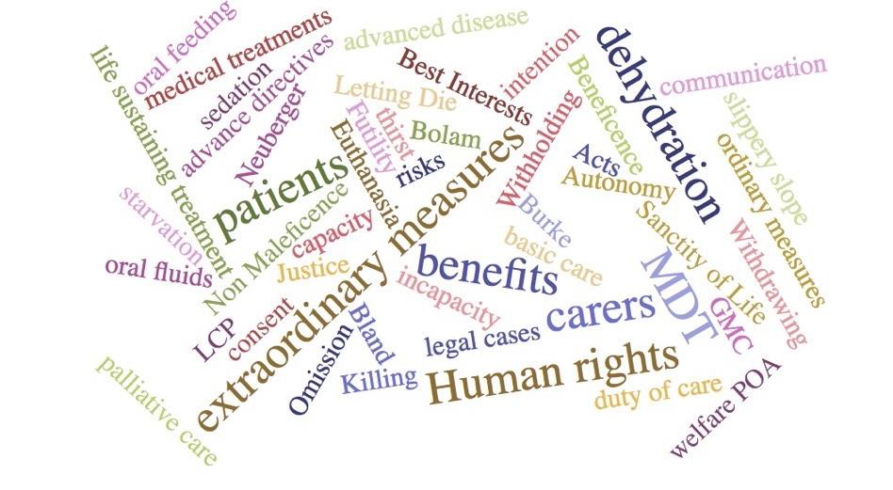
‘‘Help – What should I do?’’
Notes:
Medicine and healthcare have become much more challenging - people are no longer dying like they used to… - dying at home with family roundabout them. Its much more medicalised.
Decisions around treatment at end of life have become more complicated and there are increased expectations of what can be done!
For HCP – doing the right thing is important – if we are to allow patients to live the best possible life and in keeping with some of their preferences and choices.
Patients may have told us what they want – but don’t have the energy or the voice to stand up for what they want.
Understanding the decision making process will help us do the right thing for our patients.
People come into hospital to get things fixed.
We’re also now expecting things to happen much more quickly both in response to treatment and in death.
Other priorities become more important especially when we get to the stage where we can’t fix things. Medical interventions do not always work and there is a risk of prolonging a ‘miserable life’.
And patients when approaching the end of life.. Often choose quality over quantity.

Slide 5
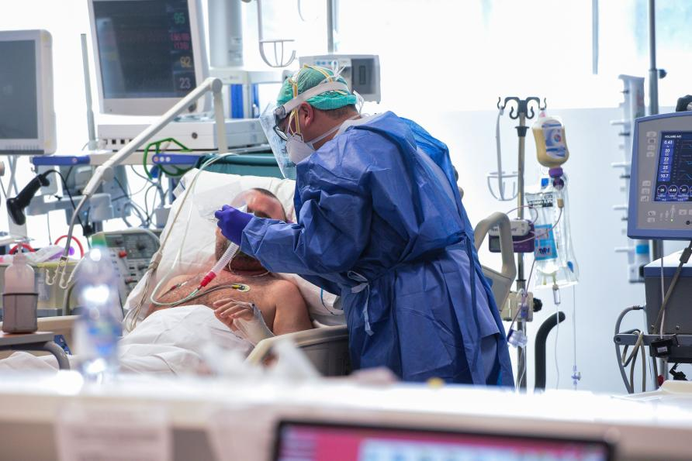
What do we do when…
48yr old, admitted to critical care following a significant AKI eGFR requiring dialysis.
Found to be HF and new dx of metastatic o’geal cancer with liver mets.
Confused due to HAP/AKI
Consultants discusses a TEP and DNA CPR and wants to withdraw active tx – not responding to tx and unlikely to get treatment for his cancer.
He has a wife, 2 children 11 and 16. 16 is doing her exams at school and family don’t want to upset her even further and want her to complete her exams. They are angry with the consultant as they think they are giving up on their husband/Dad.
What do we do?
Notes:
What is reversible
What is his prognosis
If he does recover what would his QOL be like
What is his wishes, what would he want in this situation.
What were his expectations and hopes for the future.

Slide 6

Ethical dilemmas
Facts
Opinions
values
Ethical dilemmas typically occur when values conflict
To resolve ethical dilemmas, we need to identify, and separate the facts, the opinions and the values
Ethical practice GUIDES us to what is morally right and wrong
Notes:
It can be very difficult to make decisions as some of the decisions aren’t black or white. We know by giving extra insulin for example will reduce someone’s blood sugar, but many ethical dilemmas will be based on people’s experiences, their beliefs and values. Someone may feel that their qol is the most important thing, but this may conflict against the doctors and families beliefs that they could help them to live for longer.
You don’t need to be an expert in medical ethics or law but it is important to know how to respond to ethical dilemmas that we may encounter in clinical practice.
Often ethical decisions are based on values, experiences, morals and not always facts alone which makes ethical decisions more difficult and why you may disagree with someone in your team.
Code of conduct: compassion, dignity, respect, confidentiality, listening and responding to people
Remember that there are no ‘right answers’ – but you have to be able to explain your thinking.

Slide 7

Facts
Opinions
values
Making decisions
in
healthcare
Notes:
It can be very difficult to make decisions as some of the decisions aren’t black or white. We know by giving extra insulin for example will reduce someone’s blood sugar, but many ethical dilemmas will be based on people’s experiences, their beliefs and values. Someone may feel that their qol is the most important thing, but this may conflict against the doctors and families beliefs that they could help them to live for longer.
You don’t need to be an expert in medical ethics or law but it is important to know how to respond to ethical dilemmas that we may encounter in clinical practice.
Often ethical decisions are based on values, experiences, morals and not always facts alone which makes ethical decisions more difficult and why you may disagree with someone in your team.
Code of conduct: compassion, dignity, respect, confidentiality, listening and responding to people
Remember that there are no ‘right answers’ – but you have to be able to explain your thinking.

Slide 8
Group Work – How do we go about making decisions?
In pairs/groups, discuss the following –
There is a promotion at work, but in a different hospital. Which would add an extra 25 minutes to your journey each day (each way) and cost you an extra £80 per month in travelling costs.
It’s a busy job and there’s an expectation that you may have to work additional hours occasionally.
You would be paid an additional £1800 for the first year and you would start going up increments again. This job is Monday – Friday. No more shifts or nights.
Would you take the job? What helped you make the decision?
Notes:
NB – make reference again how we may not all agree and some of us will put more emphasis on one value more than others.
Who would you talk to about it? Most of us make decisions with others/families etc.

Slide 9
Some ethical frameworks
Consequentialism
Deontology
Ethics of care
The 4 principles
Notes:
There are others – ethical theories such a deontology where we should follow our duty no matter what – ie to tell the truth always – that doesn’t work.
Consequentalism – where you make decisions based on doing the greater good for the greatest number of people.
Ethics of care – where your duty lies mostly with the one that you are caring for and regardless of the others.
The 4 principles is one of the preferred frameworks in healthcare – explained more on next slide.

Slide 10
The 4 principles in healthcare
Autonomy
Beneficence
Non-maleficence
Justice
Beauchamp and Childress (2001)
Notes:
Autonomy – is the right to self-determination and being able to make decisions and for us as HCP, to respect the decisions that someone makes. What do they understand, what is important, what are their beliefs, values? Enabling patients to make their own decisions about which healthcare interventions to accept/not accept.
Beneficence – is the moral obligation to do good.
Non – maleficence – the moral obligation to cause no harm. How easy is it, to cause no harm?
Justice – the moral obligation to equality, fairness for all.
Talk about autonomy – of action, i.ntention and thought/capacity as this is important in palliative care when patients will often lack the ‘action’ part of autonomy

Slide 11

In essence
Making decisions in healthcare is often about balancing
‘the risks versus the harms’
And then taking these back to the patient
and those close to them to make a decision
Notes:
So when does a benefit start becoming a harm?
We are often dealing with uncertainty. And dealing with uncertainty is difficult in ensuring that we don’t cause harm.
Many of our patients tell us that they’d prefer to choose quality of life over quantity.
There’s a difference in doing everything possible and doing what is best. Just because we can save people, that doesn’t always mean it’s the right thing to do.
Link this in before moving to the next slide with autonomy

Slide 12
Autonomy – In law….
Always assume that an adult is competent to make a decision, unless you can prove otherwise
A competent adult has the right to make ‘bad’ decisions/take risks
Competent adults can refuse any medical treatment, including withdrawing from current treatment even if it means that death is likely to follow
Patients cannot request/demand treatment
Decisions are made free from coercion
Notes:
An adult in Scotland – 16 or above.
by reason of mental disorder or inability to communicate because of physical disability.
Formal tools – communication, mini-mental test (MMSE), Montreal cognitive assessment (MOCA), ?psychiatry review
Discuss best interests -

Slide 13


Should Autonomy Always Be Respected?
Notes:
Can you think of any examples where we wouldn’t automatically give patients what they want?
Euthanasia?
Morphine to help them sleep?
In an emergency situation
And in people with capacity issues
What about in our life? When is our autonomy restricted? Having to wear a seatbelt, stopping at traffic lights, not killing someone.

Slide 14
A person is competent, if they are capable of ….
Communicating decisions
Retaining the memory of decisions
Understanding decisions
Making decisions
Acting
If a patient lacks capacity
then adopt the ‘best – interests’ approach to make decisions.
Notes:
incapable" means incapable of-
(a) acting; or
(b) making decisions; or
(c) communicating decisions; or
(d) understanding decisions; or
(e) retaining the memory of decisions,
People should be able to make decisions by themselves, without any evidence of coercion, manipulation.

Slide 15
Key principles of ‘best interests’ decision making
Not just medical best interests – consider a person’s welfare
What would a ‘reasonable person’ want?
Need to really consider the person and not what is best for those, roundabout them.
Take all reasonable steps to include the person in the decision making.
Consider previous and present expressed wishes, feelings
Include those caring for the person in decision making
It will depend on what is reasonable, practical and appropriate
It’s not just about reaching the right decision or a threat of being sued – but also whether the correct process is followed
Notes:
Welfare – consider the broader wishes of a person, their feelings, values and beliefs.
Bear in mind that some competent patients may hand over their decision making powers over to family.

Slide 16
For patients without capacity
Need to demonstrate/document that a person lacks capacity
Formal tools – MMSE, MoCA, AMT, communication, psychiatry review?
AWI, guardianship, PoA
Act in the patient’s ‘best interests’
Mental Health Act (2015 )
Need to assess capacity for the specific intervention
And some patients may wish to hand over the decision making to their family.
Notes:
16
Remember.. Autonomy isn’t as simple as what do they understand/retain – ‘weakness of the will and palliative care patients may have the intention but are not able to get up and do what they want. To be fully autonomous – you are said to have the capacity, the intention and also the action.
MMSE – mini mental state examination
MOCA – montreal cognitive assessment
AMT – abbreviated mental test

Slide 17
Let’s give it a go!
Treatment options case studies

Slide 18
Using the 4 principles
Autonomy: do you want the job, have enough information to make a decision? Satisfaction?
Beneficence: what benefits will the job bring?
Non-Maleficence: will the job bring me/family more harm, stress,
Justice: what are the costs, time involved?
Notes:
Remind group to use the principles for some of the case studies

Slide 19
Mrs B
Admitted to hospital unresponsive and a dense left sided weakness. She is thrombolysed and showing some small signs of recovery. She is aphasic and is unable to swallow.
She has previously told her daughter that she would not want to be artificially kept alive if there was NO chance of recovery but would want anything done to help her. A DNA CPR form is put in place.
Should she be NG fed?
Notes:
Discuss around expressing previous wishes and what does it really mean

Slide 20
Case 1
Mary is 83 yrs with advanced dementia. She is unable to communicate and does not recognise her family. She looks happy, spending her days looking after her baby doll.
She had a advance directive/living will where she had stated that she did not want any life prolonging treatment in the event of her getting a progressive, incurable illness.
She is now unwell with a severe chest infection.
Should she get IV antibiotics?
Notes:
Are IV antibiotics are life prolonging treatment.

Slide 21
Withdrawing/withholding treatment
Consider the following;-
Both Smith and Jones will inherit £600,000 if their 6-year-old nephew was to die. Both Smith and Jones go in separately to kill the nephew.
Smith sneaks in when the little one takes a bath and pushes the child under the water and he drowns.
Jones sneaks in, attempting to do the same but when he gets there, he finds the child has slipped and knocked his head and he’s struggling in the water. He leaves him to drown.
Who’s worse, morally speaking? (James Rachels)
Notes:
One is involved with killing and the other letting die.

Slide 22
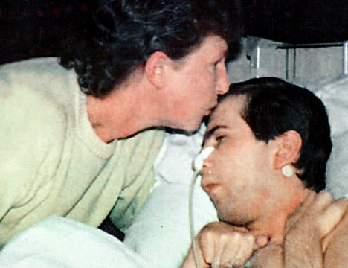
Allowing to die, assisted suicide, killing
Tony Bland
18 years old
Victim of the Hillsborough disaster
Lived for 4 years in a persistent vegetative state
Courts argued it would be classed as murder if his nutrition was withdrawn

Slide 23
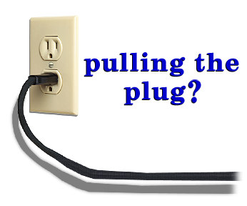
Futility
Treatment is futile if it does not have the desired effect
Treatment is futile when, although it does have the desired effect, the patient’s situation does not improve
Be clear about the intentions of an intervention (i.e. promoting comfort versus hastening death)
What is the cause of death?
  Ie the disease, stopping tx.
Notes:
Should we offer futile treatment?
Important when discussing DNA CPR
Talk about the goals of the patient and what the goals of the treatment would be.
Doctors are not legally obliged to provide any treatment that is futile.
It’s easier for families to accept if they can see that treatment is no longer working.

Slide 24
Symptom control versus euthanasia
Papa G is an 87 yr old man who is dying of an aspiration pneumonia.
He has his JIC meds prescribed. His family feel that he is really sore and very distressed and they are coming out every 2-3 hours asking for more morphine/midazolam for him.
Every time you see him – you feel he is very comfortable and don’t think he needs any morphine/midazolam
Would you give the morphine/midazolam?
Notes:
Autonomy – unable to make a decision. Any previous expressed wishes around his EOLC?
B – more comfortable? Relatives may have a better bereavement
NM – staff autonomy and morality, side effects.
J - NA

Slide 25
Hastening death and the doctrine of double effect
1. the nature of the act must be for the good or at least morally neutral
The harmful effect must be foreseen but not intended
The harmful effect must not be a way of producing the good effect
The good effect must outweigh the harmful effect, proportionately
Originally formulated by Thomas Aquinas to apply moral dilemma in which it is impossible for a person to avoid all harmful effects.

Slide 26
Autonomy
Sally has a dense R sided weakness, prone to falls due to poor safety awareness. She is a large lady. Deemed to have capacity. Wants home. She lives with her husband who agrees for discharge. PT/OT, docs, nursing staff and children do not feel that it is safe for her to go home. She says she’s happy to lie on the floor till carers come in to lift her up.
Should she go home?

Slide 27
Jack is a 59 year old man with NAFLD and is beginning to approach the end of life. He has been open with his family and they have discussed his wishes for when he’s dying and he has a DNA CPR in place, he does not want to go back into hospital and wishes to stay at home for EOLC. His 2 daughters (in their 30’s) are keen to support him with this.
However, as he deteriorates, he becomes confused (at times), prone to falls, occasional incontinence. He’s also becoming anxious and panicking. He’s calling on his daughter more and more. One of his daughters had moved in with him but feels that she can’t cope anymore and calls the ambulance for him to be admitted to hospital.
The ambulance arrives but Jack refuses to go but his daughter insists….
Should he go into hospital?

Slide 28
Autonomy
Grace is dying of end stage COPD. She is thought to be in the last hours/days of life. Her daughter asks whether she should be staying with Grace all the time. She is not overly keen to do this as she has a 5 year old daughter but feels that she should stay and be with her Mum. She asks the nurse ‘what would you do if it was your Mum?’
The nurse tells her ‘I wouldn’t go anywhere, if you want to be with her. She could deteriorate anytime’. Her daughter stays and her Mum dies peacefully 2 days later.
Did the nurse say the right thing?
Did her daughter make an autonomous decision?

Slide 29
John
John is a 48 year old man who has oesophageal cancer with new liver mets. He sees his oncologist who tells him that there are no further treatment options and introduced the idea of palliative care, for further down the line when he needs it. John and his wife were left with the impression that he had short months to live, and felt reassured by this.
He died 2 weeks later
Did the oncologist do the right thing?

Slide 30
Autonomy
Thomas previously kept well but is now deteriorating (you think he’s beginning to die) recently from his oesophageal cancer and the doctors talk to him about CPR. He’s not for HDU or ITU level care.
He says that he wants an attempt at CPR as he doesn’t feel ready to die yet and he is desperate to get to his daughter’s wedding in 4 months time.
The doctor does not put in a DNA CPR form – is this the right thing to do?
Notes:
Talk about hope and truth-telling in this slide.

Slide 31
To summarise - good decision making in HC

Slide 32
Priorities
This usually gets a lot of attention
This usually gets little attention
Condition progresses
Goals
Treatments
Notes:
We need to be honest about the diagnosis and prognosis before we can talk about the goals of treatment and goals for the patient.
And to say to people – if you’re hoping that this treatment is going to help you live longer, then that isn’t going to work. This treatment could actually make you sicker.

Slide 33


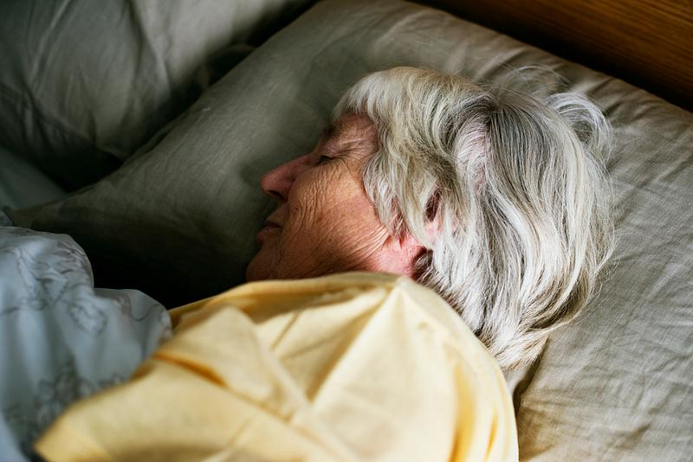
Goal setting

Slide 34
But, I wonder… as disease progresses…
Give more attention to the goals.. And then decide on treatments
Condition progresses
Goals
Treatments
Notes:
We need to be honest about the diagnosis and prognosis before we can talk about the goals of treatment and goals for the patient.
And to say to people – if you’re hoping that this treatment is going to help you live longer, then that isn’t going to work. This treatment could actually make you sicker.

Slide 35
Autonomy
My wife is dying of dehydration – shouldn’t she have a drip?
Use the 4 principles to think about this decision.
Notes:
What do we do there’s no obvious overriding priniciple? Or if the patient wants to accept the treatment even if the risks are greater than the benefits.
Could use other examples if you wish – should your patient be re-admitted to hospital?

Slide 36
The four priniples can be applied to many dilemmas in healthcare
Example: My wife is dying of dehydration – shouldn’t she have a drip?
Autonomy: How does the patient feel - Is she thirsty, hungry, dehydrated? What do they think the fluids would do?
Beneficence: What benefits would fluids bring -Reduce thirst, benefit for relative, comfort?
Non-Maleficence: What harms would the fluids cause – pain, swelling, secretions, ?prolong life
Justice: What is the cost involved?
Notes:
How do we balance these principles? We need to give honest information to patient and families, give them the risks v benefits and ask them to decide, if they wish. Can you give a trial if it’s uncertain what the response will be? Make sure it’s reviewed.

Slide 37
BRAN
B –Benefits
R- Risks
A – Alternatives
N - Nothing

Slide 38
Summary - Making treatment decisions at end of life
Explore treatment options – expectations, likely benefits, burdens or risks.
Treatment should be offered if benefits are high and burdens are low.
No legal obligation to offer treatment that is medically futile.
Remember that patients/families may not always have a clear or realistic understanding of the diagnosis or risks of a treatment. This is particularly the case in CPR and parenteral nutrition and the public’s knowledge of the clinical complexities may be limited.
If the outcome of treatment is uncertain, then treatment can be offered to make a clearer assessment eg often happens with antibiotics at end of life
Inform patients/families that treatment may be withdrawn if not having the desired effect.

Slide 39
What guides our practice?
Our own professional codes of practice
Scottish palliative care guidelines
Treatment and care towards the end of life: good practice in decision making (GMC 2010)
Realistic conversations: shared decision making in practice (NES emodule)
Realistic medicine
Healthcare quality strategy for NHS Scotland (2010)
Decision making and consent (GMC 2020)
Adults with Incapacity Act (Scotland) 2000
BMA – best interests decision making for adults who lack capacity

