Slide 1

Management of Constipation Palliative Care Module – Day 4

Slide 2
Your Experiences…
Is constipation assessed and managed well in your area?
Are you a bowel Nurse ?
Notes:
Ask group for a definition of constipation

Slide 3
Constipation is…
…defecation that is unsatisfactory because of infrequent stools, difficult stool passage or seemingly incomplete defecation. Stools are often hard and can be abnormally small or large. Constipation can cause unpleasant symptoms, such as abdominal and rectal pain , distension , nausea and vomiting and other negative effects on the patient’s wellbeing. As well as the physical suffering , constipation can cause psychological distress and agitation. (ref: SPCG 2026)
Notes:
There are many reasons why patients with palliative care needs may develop constipation.
Constipation can be complex and may require specialist advice if the current treatment regime is not successful.
Ask group how would be assess ?

Slide 4
Assessment
A full assessment of the patient and their symptoms should be made, looking at:
Identify normal & current bowel pattern
Current or previous treatment
Effectiveness of any treatment
Clinical features
Is there pain
Nausea, vomiting, anorexia
Flatulence, bloating, malaise
Overflow diarrhoea
Urinary retention
Notes:
Identify normal bowel pattern - frequency, consistency, ease of passage , blood?, pain? - So whats normal for you ?
Current or previous treatment – regularly taken ? PRN basis
Abdominal examination may help identify abdominal pain, faecal loading , ascites.
Rectal or stomal examination can be useful to identify hard stools or masses.
Consider whether examinations would cause undue stress for the patient.
Ask for possible causes

Slide 5
Possible causes of constipation
Medication (opioids, antacids, diuretics, iron, 5HT3 antagonists, anticholinergics)
Secondary effects of illness (dehydration, immobility, poor diet, anorexia)
Tumour in, or compressing, bowel wall
Damage to lumbosacral spinal cord, cauda equina or pelvic nerves
Hypercalcaemia , hypokalaemia, hypomagnesaemia
Concurrent disease such as diabetes, hypothyroidism, diverticular disease, anal fissure, haemorrhoids, Parkinson’s disease
Notes:
You may hear -Lack of Fibre . Not drinking enough, , inactivity, Dietary changes , Stress, anxiety & depression
Here are some other possible causes of constipation In palliative care patients .
Its important to clarify the cause before starting the treatment.
So ask group how do we manage constipation ?

Slide 6
Management
The aim of management is to achieve comfortable defaecation, rather than any particular frequency of bowel motion.
General Advice:
Encourage a good oral fluid intake (1.5 - 2 litres per day if able)
Review dietary intake ( aim to increase fibre unless contraindicated, eg. Bowel obstruction)
Ensure patient has privacy and access to toilet facilities. A foot stool to elevate knees may help.
Encourage daily exercise according to ability.
Review reversible factors contributing to the constipation (eg. including deprescribing any contributing medications)
Notes:
Eg. Aluminium containing antacids ( iron , calcium supps)
Analgesics , opioids & NSAIDs
Antidepressants , tricylic
Antipsychotics , clozapine , quetiapine
Antispasmodics . Hyoscine butylbromide
Antihistamines
Diuretics

Slide 7
Management
General Advice:
Do not delay treatment whilst waiting for the results of investigations such as blood tests.
Laxative doses should be titrated according to individual response.
If current regimen is satisfactory and well tolerated continue, but review patient regularly and explain importance of preventing constipation.
Use oral laxatives if possible in preference to alternative routes of administration
Co-prescribe laxatives when commencing opioids
Notes:
Remind group - Not a specific palliative care problem but often a forgotten symptom
Significant consequences if left untreated including delayed discharge …
Management must follow a holistic assessment.
There are lots of good non pharmacological measures !!!

Slide 8
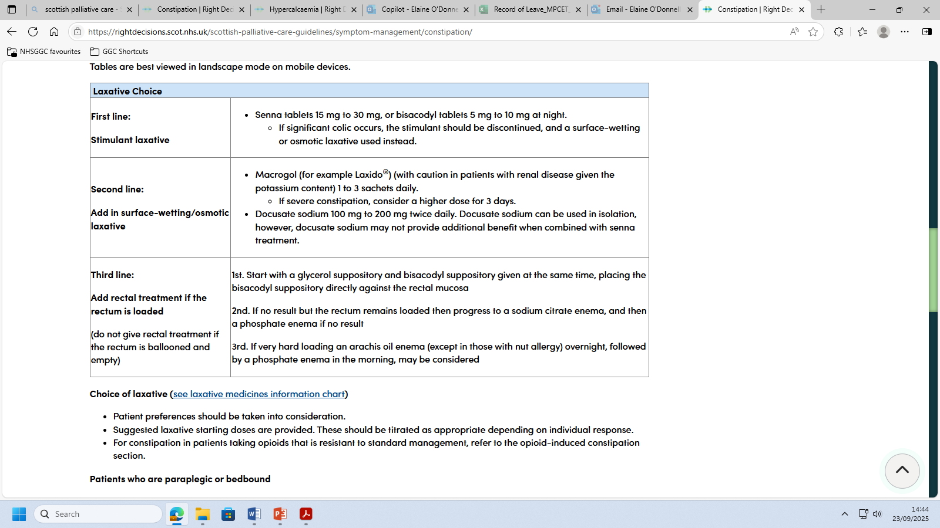
Notes:
Choice of laxative
Pt preference should be taken into consideration
Suggested laxative starting doses provided
Lactulose is not effective without a high fluid intake; it can cause flatulence and abdominal cramps in some patients.

Slide 9
Other Considerations
Paraplegic or bedbound patient
Opioid-induced constipation
Bowel Obstruction
Documentation !!
Use of assessment Tools / visual aids
Notes:
Patients who are paraplegic or bedbound
Adjust laxitives or add constipating medications such as loperimide – according to individual response – aim soft but formed stool
Commence ‘bowel regimne’ regular rectal intervention every 1-3 days to avoid impaction leadeing to faecal incontinence , anal fissures or both
Opiate induced constipation – All opioids may cause constipation. Commonly worsens as doses increase .
We should communicate this risk and initially prescribe prn laxatives. Often people require prescribing on a regular basis
If pain stable and constipation not responding – consider swith to fentanylwith specialist advice . ?less constipating
Thre are medicines peripherally acting u opioid receptor antagonists that can relieve constipation
whilst preserving the central effects of the opiates. Oral PAMORAs may be considered NALOXEGOL or NALDEMEDINE,
**Must not be used in patients who have been diagnosed with bowel obstruction or risk of GI perforation**
Bowel Obstruction
3 Types of obstruction:
Simple - blocked in 1 place
Closed loop - blocked in 2 places
Strangulated - reduced blood flow to bowel
Medical management – analgesics, anticholinergic's, antiemetic's, potentially octreotide, resting of the bowel, NG tube, venting gastroscopy
Surgery – not possible if multiple levels of obstruction, poor performance status, recurrent ascites

Slide 10
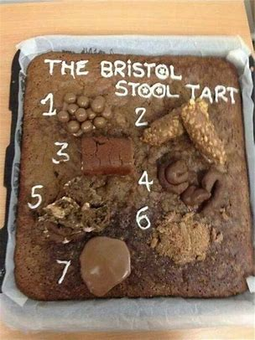
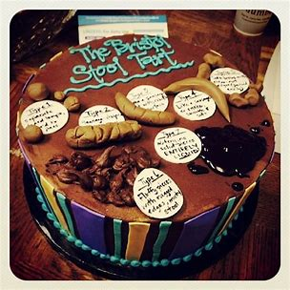
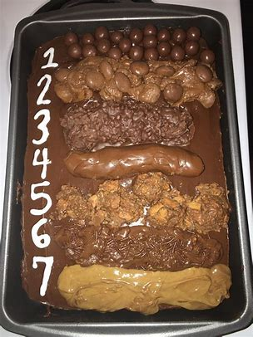
Notes:
The Bristol stool chart – classification of the seven types of human faeces based on consistency .
Simple visual aid .Can help monitor bowel health , assess conditions & evaluate trestments
Range from 1-7 1 ? Constipation , 7 indicative of diarrhoea
Type 4 - the sausage or snake like smooth and soft – is considered most ideal

Slide 11

Practice Points
Notes:
Ask the participants to read the practice points themselves

Slide 12

Remember … Think Scottish Palliative Care Guidelines…
Constipation | Right Decisions

