Slide 1

Opioids in Palliative Care
Conversions : Palliative Care Module – Day 3

Slide 2
Scottish Palliative Care Guidelines
(Choosing and Changing Opioids)
Opioids are used for pain and breathlessness
Most people with palliative care needs respond well to titrated oral morphine
For frail/elderly. Consider a lower starting dose of opioid
Seek specialist advice if the patient is in moderate to severe pain with frequent use of breakthrough medication , in other words more than three doses in 24hours

Slide 3
Scottish Palliative Care Guidelines
(Choosing and Changing Opioids)
A small number of patients may need to be changed to another opioid if:
Oral route is not available
Pain is responding but the patient has persistent intolerable side effects (consider reducing the dose and titrating more slowly or adding an adjuvant analgesic before changing opioid)
Moderate to severe liver or renal impairment
Poor compliance of oral medication
Complex pain (consider adjuvant analgesics/ other pain treatments)

Slide 4
Opioid Conversions
Opioid/opiate conversion tables – switching between opioid medicines | Right Decisions

Slide 5
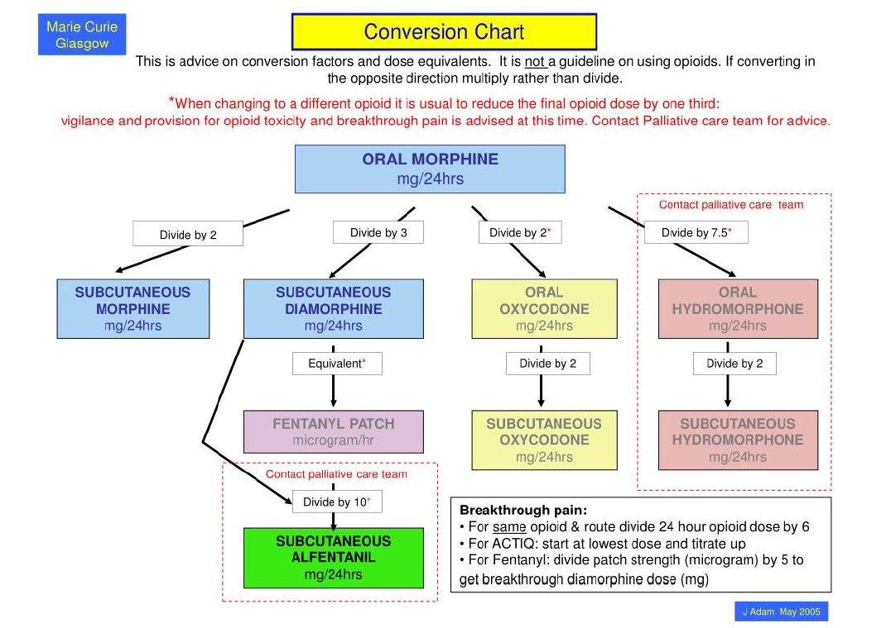

Slide 6


Opioid Conversions
oral morphine to s/c morphine
  Divide by 2
oral oxycodone to s/c oxycodone
  Divide by 2
morphine to oxycodone
  Divide by 2

Slide 7
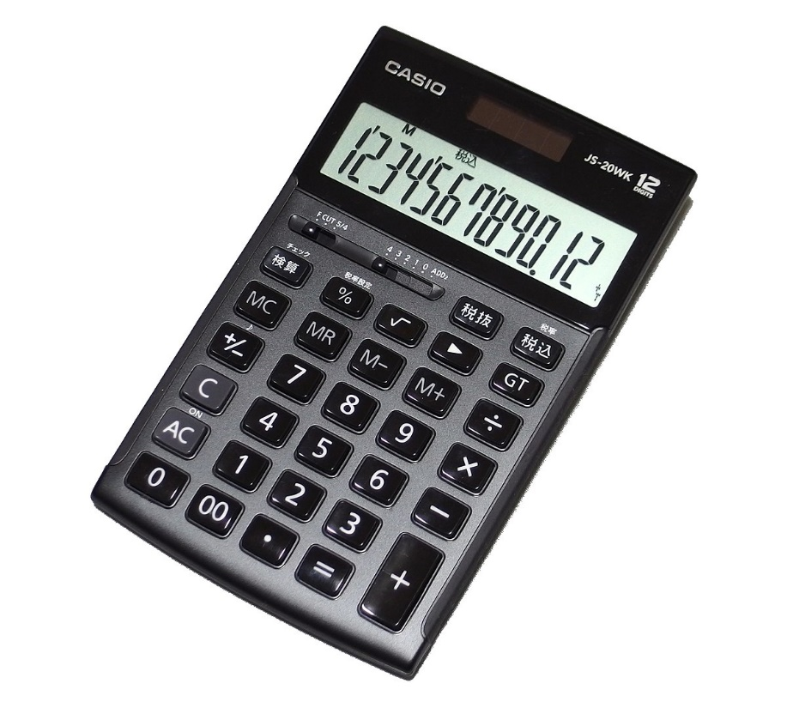
Opioid Conversions
oral morphine to s/c diamorphine
  Divide by 3
oral morphine to s/c alfentanil
  Divide by 30

Slide 8
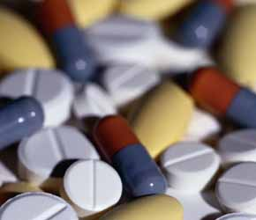
Opioid Conversions
Codeine 30mg
  3mg Immediate release morphine (÷10)
Tramadol 50mg
  5mg Immediate release morphine (÷10)
Fentanyl patch 25mcg/hr
  60-90mg oral morphine/24hrs
Buprenorphine 5 mcg patch
  12mg oral morphine/24hrs
  (x 2.4)

Slide 9

Points to Remember
Breakthrough analgesia
(1/6th – 1/10th of the total regular daily dose of opioid)
If changing to different drug or route of administration guidance suggests reduce total dose initially by 1/3
Remember the formula – what you want, over what you’ve got x the volume.
Notes:
9

Slide 10
Question 1
Patient is on Oxypro (oxycodone MR) 15mg BD.
What is the breakthrough dose?

Slide 11
Question 1
Patient is on Oxypro (oxycodone MR) 15mg BD.
What is the breakthrough dose?
15 x 2 = 30mg daily
divide by 6 = 5mg

Slide 12
Question 2
Patient has oxycodone 30mg in a SC syringe pump over 24 hours.
What should the breakthrough dose be?

Slide 13
Question 2
Patient has oxycodone 30mg in a SC syringe pump over 24 hours.
What should the breakthrough dose be?
30mg daily
divide by 6 = 5 mg

Slide 14
Question 3
Patient is on Morphine MR (Zomorph) 20mg BD and is using Oramorph 4 x 5mg daily.
What would you suggest putting their Zomorph up to?

Slide 15
Question 3
Patient is on Morphine MR (Zomorph) 20mg BD and is using Oramorph 4 x 5mg daily.
What would you suggest putting their Zomorph up to?
Daily Zomorph 20mg x 2 = 40mg
Daily Oramorph 5mg x 4 = 20mg
40 + 20 = 60mg daily, divide 2 for BD dose = 30mg BD
*It can be safe to increase someone’s opioid by 25-30% daily*

Slide 16
Question 4
Patient is on Morphine MR (Zomorph) 60mg BD and needs switched to Oxycodone.
What dose of oxycodone would you give?

Slide 17
Question 4
Patient is on Morphine MR (Zomorph) 60mg BD and needs switched to Oxycodone.
What dose of oxycodone would you give?
60 x 2 = 120mg morphine daily,
divide by 2 for oxycodone; 120 divide by 2 = 60mg oxycodone daily
New drug, dose reduce by 30%, 60mg -20mg = 40mg daily.
Split to BD dosing, divide by 2; 20mg BD

Slide 18
Question 5
Patient is on Morphine 30mg BD (Zomorph) and needs switched to Alfentanil due to renal impairment.
What dose of Alfentanil would be used over 24 hours?

Slide 19
Question 5
Patient is on Morphine 30mg BD (Zomorph) and needs switched to Alfentanil due to renal impairment.
What dose of Alfentanil would be used over 24 hours?
30mg oral morphine is equal to 1mg sc Alfentanil
30 x 2 = 60mg morphine daily.
Divide by 30 = 2 mg of Alfentanil.
New drug, dose reduce 30%, 2mg – 0.6 = 1.4 mg Alfentanil daily

Slide 20
Question 6
Patient is prescribed SC Morphine 7mg prn. The vial is 10mgs per ml.
How many ml do you give?

Slide 21
Question 6
Patient is prescribed SC Morphine 7mg prn. The vial is 10mgs per ml.
How many ml do you give?
1ml divided by 10 = 0.1ml
0.1ml = 1mg; therefore 7mg = 0.7ml

Slide 22
Question 7
A patient has breakthrough oral Morphine 15mgs prn prescribed but is unable to swallow.
What dose of SC morphine do you give?

Slide 23
Question 7
A patient has breakthrough oral Morphine 15mgs prn prescribed but is unable to swallow.
What dose of SC morphine do you give?
15mgs divide by 2 = 7.5mg.
Remember! Avoid decimal point so use 7mg SC

Slide 24
Question 8
A patient has a fentanyl 50 mcg/hr patch in situ and is very sore. He has oramorph 2mg prescribed prn.
Is this the correct dose?
If not, what would the correct dose be?

Slide 25
Question 8
A patient has a fentanyl 50 mcg/hr patch in situ and is very sore. He has oramorph 2mg prescribed prn.
Is this the correct dose?
No
If not, what would the correct dose be?
In SPCG Opioid/opiate cOpioid/opiate conversion tables – switching between opioid medicines | Right Decisions
onversion tables – switchingOpioid/opiate conversion tables – switching between opioid medicines | Right Decisions
between opioid medicines | Right Decisions
Fentanyl Patch 25 micrograms/hr = Morphine 60mg-90mg
50 mcg Fentanyl = approximately Morphine 120mg-180mg
To calculate breakthrough dose divide by 6
Lower range 120mg divide by 6 = 20mg

Slide 26
Any Questions?

