Slide 1

Communication Skills Palliative Care Module – Day 2

Slide 2
Communication Skills Introduction (Session 1)

Slide 3
Aims
Understand the skill and knowledge that underpins effective communication
Be aware of the barriers and behaviours that affect communication
Explore communication strategies
Be aware of communication frameworks to use in practice

Slide 4
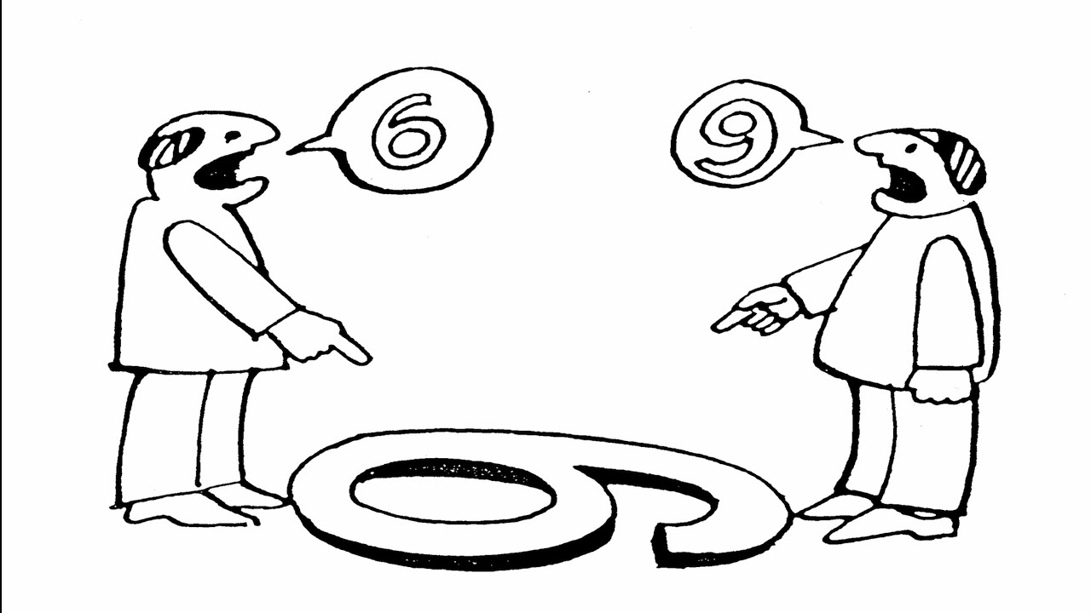
Communication is Complex!
Notes:
Interesting slide to start off with as we can see how different viewpoints can lead to misunderstanding.
Ask what is communication?

Slide 5
‘.. communicating effectively is essential to a positive, inclusive and people-centred culture in which staff feel valued, empowered, and supported to deliver the best experience and outcomes for our patients.’
(Ref: The Christie Institute for Cancer Education Manchester 2025)
Notes:
The evidence tells us that better communication leads to better care and the communication training has the potential to strengthen
patient experience, support staff wellbeing and build a more confident and resilient workforce.

Slide 6
Activity
Write down 5 communication skills you use when talking to patients/ residents/ families
Notes:
Group work – use x2 separate flip charts to write down the verbal and non-verbal communication skills.
Talk around each skill

Slide 7
Non-Verbal Communication Skills
Body language
Positioning
Active listening
Cues
Pitch, pace and tone
Good eye contact
Mirroring
Facial expressions
Gestures
Appropriate touch
Paralinguistic skills (pitch, tone, pace, volume)
Pauses/silence
Notes:
Talk around next two slides .. Tick off any skills noted in previous two exercises/ activities.

Slide 8
Verbal Communication Skills
Questioning styles
(open, close, checking, probing, no multiple)
Cues
Paraphrasing/reflecting back
Educated guess
Chunk and check (max 3)
Clarifying
Summarising
Acknowledging feelings/empathy
Minimal prompts
Screening
No jargon
Establishing rapport
Verbal Fillers – (hmm, uhu )
Notes:
Compare to flip charts and validate group work.
Finish with: Mehrabian’s theory-how is communication broken down into verbal and non verbal? Ask class.
7% verbal and 93% non verbal.
The 93% is broken down into 55% of the message conveyed through body language and 38% through expression and tone of voice.

Slide 9

Time for a rest (Tea-break)

Slide 10
Having challenging but necessary conversations Session 2
Notes:
Ask what is a challenging but necessary conversation ?
Mention Linguistics and use of word necessary etc

Slide 11
What prevents health care professionals from having challenging but necessary conversations with patients / residents / relatives?
Notes:
Brain Storm with Class

Slide 12
Barriers to Communication Healthcare professionals
Fears:
Unleashing strong emotions
Upsetting patient/relatives
Being asked difficult questions
Damaging the patient
Lack of communication skills
No privacy
Beliefs:
Not my role/job
Will take too long
Patient will not cope
Will not receive support from team

Slide 13
What prevents patients/residents and their families from asking health care professionals about their worries and concerns?
Notes:
Brain Storm with Class

Slide 14
Barriers to Communication Patients/Residents/Relatives
Fears:
Being stigmatised
Being judged as ungrateful
Crying/breaking down
Burdening health professional
Causing distress to health professional
Denial of situation
Other reasons:
Patient cannot find the right words
Does not have command of the language
Protecting relatives
Patients cues for information met by blocking/distancing behaviours

Slide 15
Active Listening or Blocking Out
Notes:
Sometimes we can choose to listen , sometimes we can block. This describes our human ability to control our attention and engagement with information distinguishing between active listening and blocking out sounds or messages.
Choosing to listen involves giving full thoughtful attention, while blocking involved intentionally or unintentionally disregarding information that is perceived as less important or overwhelming.

Slide 16

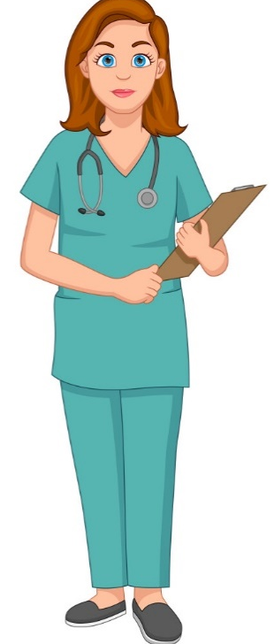
How do we block?
Avoiding the person
Talk about yourself
Jollying along
Passing the buck
Switching Topics
Selective attention to cues
Normalising or Stereotyped
Comments
Inappropriate Encouragement or Advice
Closed Questions
Premature or
False Reassurance
Giving Your Opinion
Switching focus to Relatives
Premature Problem Solving
Minimising concerns
Notes:
16
Blocking examples:
Patient: “Nurse, am I going to die?”
Nurse: “Do you know what, you could speak to the nightshift staff about that…” (Passing the buck)
Nurse: “No, not on my shift.” (Jollying along comments)
Nurse: “Everyone feels like that” (Normalising)
Nurse: “Of course you’re not dying.” (Premature or false reassurance)
Nurse: “Did you manage to get the radio working last night?” (Switching topics)
Nurse: “Awh, you’re fine. Listen, there are poorer souls than you in here.” (Premature or false reassurance)
Nurse: “What goodies did your wife bring you up last night?” (Switching focus to relatives)

Slide 17
Activity
Write down on Post-It note provided a question that patients/residents or families ask that makes you nervous
Stick your Post-It note on flip chart
Notes:
Once all notes collected, share with class that we will discuss and respond later.
Facilitators will theme questions to help with discussions.
Cover as many as you can using the communication skills strategies that class have learned from previous group work.

Slide 18
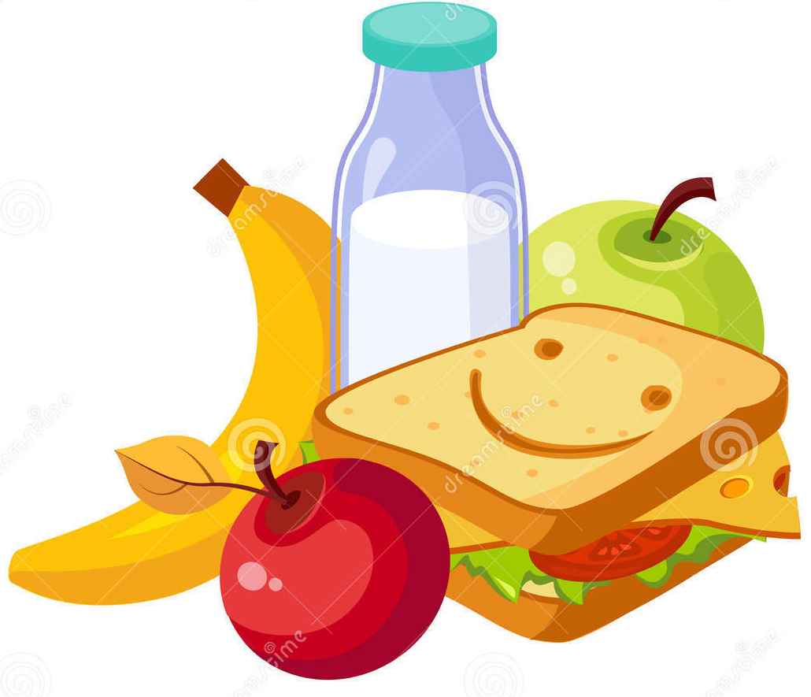
Time for a longer rest (Lunchtime)

Slide 19
Communication Skills in Action: Interactive Videos and Things That Help Session 3

Slide 20
Comms Skills Clips

Slide 21
Comfort Break

Slide 22
Other things that can help :

Slide 23
Breaking Bad News - SPIKES
S - SETTING UP the Interview
P - Assessing the Patient’s PERCEPTION
I - Obtaining the Patient’s INVITATION
K - Giving KNOWLEDGE and information to the Patient
E - Addressing the Patient’s EMOTIONS with empathetic responses
S - STRATEGY and SUMMARY
Notes:
Discuss what communication models are …
This is the model used by medical students and doctors to break bad news. Tell the class that there are many models for BBN.
S-Setting up the interview. Its about Preperation. Eg. Finding a quiet place , handing over keys , limiting interruptions , water , tissues , seating
P-Perception. This is your checking question. What does the patient understand? What have they been told so far?
I-Obtaining Invitation. Asking the patient is it ok to talk? Do you have their consent? Do they want their relative/friend present?
K-Giving Knowledge and information to the patient. Is the patient happy to have all the information or do they just want the pertinent points? (chunk and check-3 pieces of information. Eg. We have the results of your scan, Mr Smith. Unfortunately (warning shot) it shows a cancer in your left lung. We would like to discuss treatment options that may help).
E-Addressing the patient’s Emotions with empathetic responses. This is acknowledging feelings. Compassionate concern on how the patient is feeling after what you have told them.
S- Strategy and Summary . This is the follow up plan about what next happens to the patient and the summary is either asking the patient what they have understood from the interaction or the health professional summarising

Slide 24
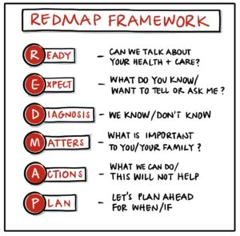
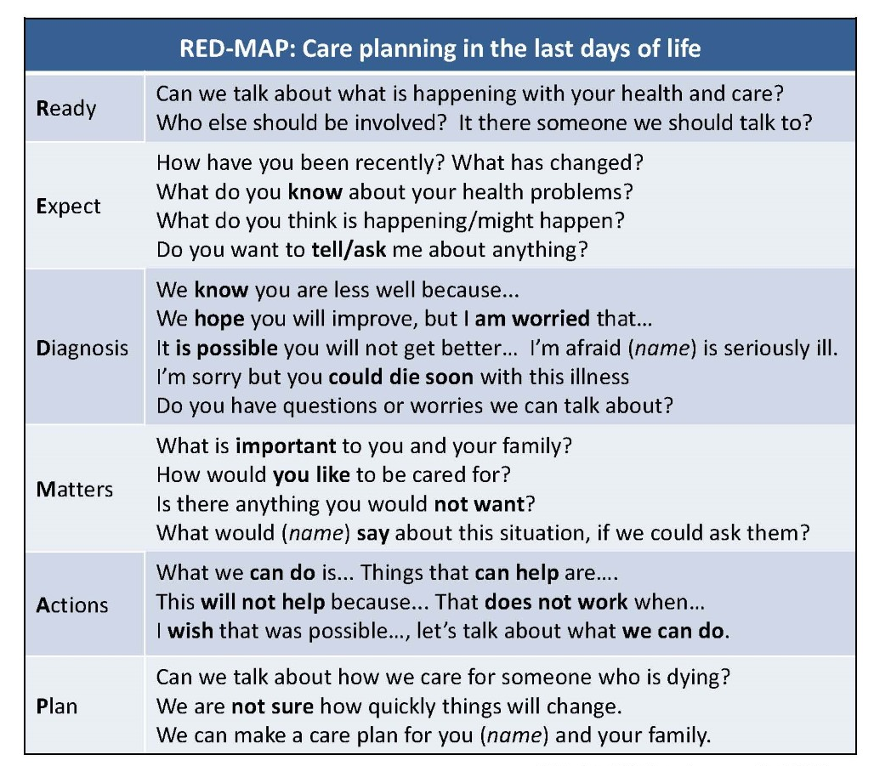
REDMAP
Notes:
REDMAP (youtube.com)
So here is a tool that might help with challenging but necessary conversations.
It can aid /help support effective communication , necessary conversations around future care planning and care around dying.
It a simple 6 step to help with planning treatment and care when a persons health is deteriorating.
It supports parallel planning … that is hoping for the best while preparing for the worst / a poorer outcome. This is important when there is uncerainity.
The order of the steps is important .
ASK : Has anyone seen or used this before ?
Hand out copies of REDMAP
Ready – People benefit from knowing what the discussion is about. Encourage them to involve family, PoA
Expect – we need to have a good idea of what people know and expect to happen. They may have questions or worries they want to talk about.
Diagnosis – Now we are better prepared to share information to the person and those close to them – this may be bad news. Begin with what we do not – then what we don’t.
Matters – Asking people to tell us what is important to them comes after they have a reasonable understanding of their current situation and what might happen.
Action – In REDMAP we speak about what we CAN do first and are clear about treatments and what will not work or risk leaving a person in much poorer health.
Plan – Finally we make plans for treatment and care together.

Slide 25
Delivering the news of a death by telephone
Notes:
Delivering the news of a death by telephone on Vimeo
Play video and siPromote the SAD website

Slide 26
Challenging but necessary conversations
using REDMAP
Notes:
Hand out REDMAP to all.
Discuss the REDMAP model as a tool to help with Future Care Planning/PPC & PPD discussions. Developed by Kirsty Boyd, retired Palliative Care Consultant in Edinburgh, who is now developing the Strategic Palliative Care Strategy for Scotland.
Go through the REDMAP acronym and discuss each letter.
Discuss the REDMAP model as a tool to help with Future Care Planning and PPC/PPD discussions. Developed by Kirsty Boyd, retired Palliative Care Consultant in Edinburgh, who is now developing the Strategic Palliative Care Strategy for Scotland.
Go through the REDMAP acronym and discuss each letter before handing over to co-facilitator.
Co –facilitator explains ‘goldfish bowl’ technique to group and asks for a volunteer to play the nurse. Go through Mary’s scenario using REDMAP. One facilitator plays patient role (Mary) and the other facilitator leads the goldfish bowl and takes suggestions from the group at each stage of REDMAP. Ask group to provide feedback to the nurse on what non-verbal and verbal communication skills that they see being used effectively. Facilitator can also feedback what communication skills they have observed if need be.

Slide 27
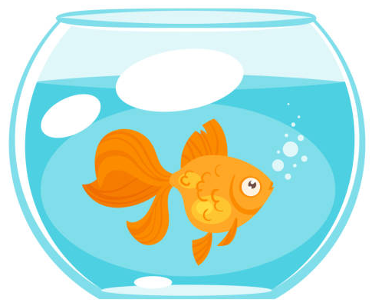
Interactive Demonstration – Goldfish Bowl
Notes:
Pick a scenario from the group and write it up on flip chart.
Alternative scenario follows
Discuss scenario with class and ask them to have an aim /goal of conversation – write up
Ask for 3 things that they could do/ use to help them reach goal/ meet goal in terms of communication ( objectives)
Now explain Goldfish bowl technique to class:
Two people are required for demonstration purposes - one playing health care professional the other a patient/resident/relative
Ask for a group participant to play the Nurse.
The health care professional uses REDMAP to show the progress of discussion with patient/resident/relative.
The demonstration facilitator leads the goldfish bowl by taking suggestions from the class that the healthcare professional could use to help facilitate the discussion.
It is important to express that it is not the HCP skills that are on show.
The 2 individuals doing the role play parts must stay in role and not interact with the class.
They must only use the suggestions provided by the class and not ad lib or change the wording of what someone says. ( they can use pen & paper if this helps)
At each stage of REDMAP, the class are asked to provide feedback to the health care professional on what non-verbal and verbal communication skills that they see being used effectively. Lead facilitator can also feedback any communication skills they have observed, to consolidate teaching.

Slide 28
Scenario
James is a 48yr old gentleman who has been diagnosed with advanced Pancreatic Cancer and Liver metastases three weeks ago.
He lives at home with his partner Sue and their two children, Paul who is 12 years old and Jamie who is 8 years old
He has a plumbing business but has not worked since his diagnosis
You have been asked by the GP to visit James at home for venepuncture. James asks you if he can speak to you about his condition as he is planning a big family holiday to Florida next year.

Slide 29
REDMAP – Talking about getting less well
Ready: Start or continue conversations about care planning
Expect: Find out what people know and are thinking about or worried about
Diagnosis: What we know is that…
We are not sure about…
We hope you will stay well improve, but I/we are worried about …
We don’t know exactly what will happen but having a plan helps.
Matters: What is important to you (and your family) that we should know about?
Are there things you’d like, or would not want to happen?
Actions: What we can do is…
Options that can help are…
That does not work/help when…
Plan: Having a plan helps us know what to do if things change. We review it regularly.
Notes:
REDMAP (youtube.com)
Explain that REDMAP is a communication tool which helps with difficult conversations and future care planning. Goldfish bowl with participants to highlight structure. Leave slide on view to help nurses follow the tool. Discuss good communication strategies when following the REDMAP structure. Acknowledge feelings and use sensitive language before moving on to each step.

