Slide 1
Prescribing in SCRH
Dr Lorena Mihaita
Obstetrics& Gynaecology ST2

Slide 2
Prescribing in Pregnancy
Useful resources:
Maternity Services Guidelines for regularly used medicines (intranet)
UK Teratology Information Service (UKTIS) https://uktis.org/
Specialist Pharmacy Service (SPS) – Safety in Pregnancy https://www.sps.nhs.uk/home/guidance/safety-in-pregnancy/
Best Use of Medicines in Pregnancy (BUMPS) patient information leaflets https://www.medicinesinpregnancy.org/
Notes:
UKTIS – summaries available, request free log-in to see full monographs (need NHS email address)

Slide 3
Antibiotics
Trimethoprim - avoid in first trimester (folate antagonist, increased risk of neural tube defects)
Nitrofurantoin - avoid in the third trimester (risk of haemolytic anaemia in baby)
Co-amoxiclav- generally avoided in pregnancy, very important to avoid in preterm prelabour rupture of membranes (PPROM) due to increased risk of necrotising enterocolitis in the newborn
Tetracyclines - can affect bone and teeth development in baby
Quinolones - theoretical risk of arthropathy for fetus2
Notes:
Sometimes antibiotics such as tetracyclines or quinolones may be considered for serious or life-threatening conditions unresponsive to other antibiotic therapies considered suitable for use in pregnancy. Where possible, the results of culture and sensitivity tests should be available before making an antibiotic treatment choice in accordance with local prescribing guidelines.

Slide 4
Anti-emetics
Familiarise yourself with the Nausea and Vomiting in Pregnancy guideline for preferred options
Ondansetron – possible small increased risk of orofacial clefts if used before week 11, (background risk = 11 cases per 10,000, with ondansetron = 14 cases per 10,000). Should not be withheld if first-line options are ineffective, see Nausea and Vomiting in Pregnancy guideline for more information.
Notes:
https://uktis.org/monographs/treatment-of-nausea-and-vomiting-in-pregnancy/
https://uktis.org/monographs/use-of-ondansetron-in-pregnancy/

Slide 5
Antihypertensives
See Hypertension guideline for preferred options in pregnancy and breastfeeding
ACE-inhibitors e.g., lisinopril - risk of fetal urinary tract abnormalities
Angiotensin receptor blockers e.g., candesartan - risk of fetal renal dysfunction, lung hypoplasia, skeletal malformations
Diuretics – risk of congenital anomalies and neonatal complications
Beta-blockers – labetalol is preferred but others may be used in certain situations
Notes:
https://uktis.org/monographs/use-of-angiotensin-converting-enzyme-inhibitors-in-pregnancy/
https://uktis.org/monographs/use-of-angiotensin-ii-receptor-antagonists-in-pregnancy/
https://uktis.org/monographs/use-of-diuretics-in-pregnancy/
https://uktis.org/monographs/use-of-beta-adrenoceptor-blocking-drugs-beta-blockers-in-pregnancy/

Slide 6
NSAIDS
Avoid NSAIDs (e.g., ibuprofen, diclofenac, naproxen) in pregnancy, especially after 20 weeks due to risk of fetal renal dysfunction, premature closure of ductus arteriosus
Contraindicated after 28 weeks
If use of an NSAID after week 20 of pregnancy is considered necessary, prescribe at the lowest effective dose for no more than 3 days and consider additional monitoring if used for longer than this
This warning does not apply to low dose aspirin (150mg) used in pregnancy for prevention of PET
Notes:
https://www.gov.uk/drug-safety-update/non-steroidal-anti-inflammatory-drugs-nsaids-potential-risks-following-prolonged-use-after-20-weeks-of-pregnancy
https://uktis.org/monographs/use-of-non-steroidal-anti-inflammatory-drugs-nsaids-in-pregnancy/

Slide 7
Prescribing in Breastfeeding
Don’t rely on the BNF!
Useful resources:
Specialist Pharmacy Service (UKDILAS) https://www.sps.nhs.uk/home/guidance/safety-in-breastfeeding/
E-Lactancia https://e-lactancia.org/
LactMed https://www.ncbi.nlm.nih.gov/books/NBK501922/
Please get a second check before advising against breastfeeding

Slide 8
Discharge Medicines
Different medicines are prescribed on discharge depending on the type of birth:
Caesarean section- Paracetamol + Ibuprofen+ oral morphine solution + laxatives + LMWH
Spontaneous vaginal delivery- Paracetamol + Ibuprofen (if required)
Instrumental delivery- Paracetamol + Ibuprofen + Dihydrocodeine (if required)
3rd/4th degree tear- Paracetamol + Dihydrocodeine + antibiotics + laxatives
Check VTE score has been calculated correctly and prescribe LMWH for correct duration (10 days or 6 weeks) if indicated – ensure duration is clearly documented on IDL
All patients receive oral iron (ferrous sulphate) as per PRAMS (Pregnancy Anaemia Management Scotland) – follow the antenatal and postnatal flowcharts at http://intranet.lothian.scot.nhs.uk/Directory/ReproductiveMedicine/PoliciesAndGuidelines/Documents/SOP/PRAMS%20SOP.pdf
Postpartum contraception - ask during postnatal ward round if possible.
Notes:
Remember to withhold oral iron for 5 days post-IV iron.

Slide 9
Top Tips for Discharge Letters
Reduce ibuprofen frequency to three times daily
Reduce oral morphine solution frequency to 4-6 hourly
Remember to authorise the letter once complete to send to GP

Slide 10
Top tips for Obstetrics
Familiarise yourself with maternity services guidelines - there are specialty-specific guidelines for e.g., antimicrobials, thromboprophylaxis, nausea and vomiting etc.
When calling microbiology, be ready to tell them if patient is antenatal or postnatal/ how many weeks/if they are breastfeeding
Do not prescribe induction agents (Propess/dinoprostone) or oxytocin for labour augmentation unless agreed by a registrar.

Slide 11
Gynaecology
Much larger age range; similar to general medical wards/MOE
Complete medicines reconciliation on admission to the ward – print the ECS and use one other source (ideally patient/carer, check if patient has brought own medicines)
Please read Operation note for information on LMWH course (depends on procedure and surgeon)
Prioritise IDLs for patients with e.g., dosettes, MAR charts, controlled drugs – must be received in Pharmacy by 3pm for same day dispensing

Slide 12
Gentamicin in pregnancy
Higher Volume of Distribution
Increased drug clearance
Shorter half-life
Altered pharmacokinetics
Therefore, there is a different recommendation for patients who are:
Antenatal
Intrapartum
Post-partum (1st 72 hours post-delivery)
These patients group require twice daily dosing
Notes:
Example objectives
At the end of this lesson, you will be able to:
Save files to the team Web server.
Move files to different locations on the team Web server.
Share files on the team Web server.

Slide 13
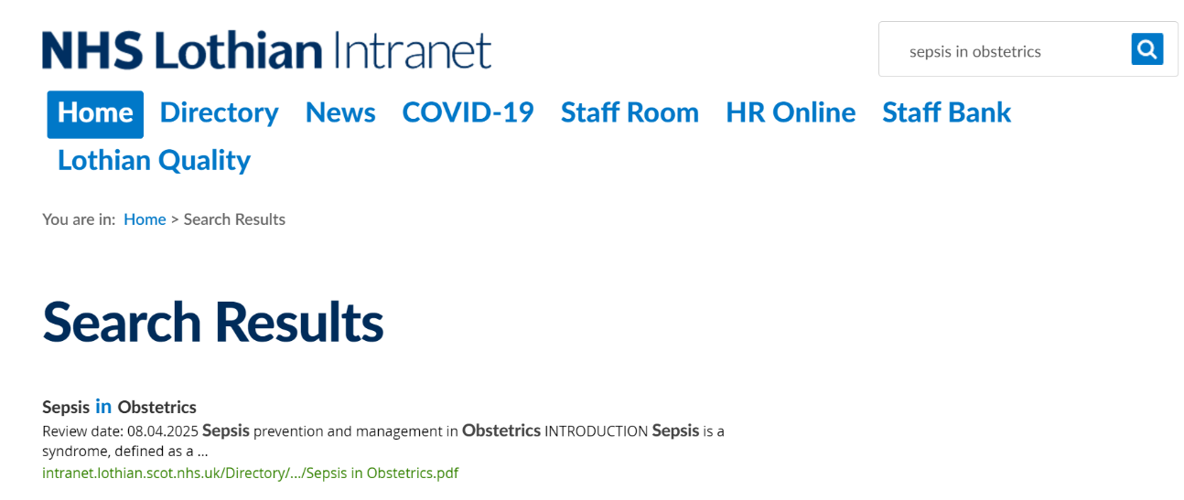

How to find guideline
Search for ‘Sepsis in Obstetrics’ on Intranet’s search bar
Section on Gentamicin prescribing can be found on page 13 of the above guideline

Slide 14
Calculating the initial dose
1. Calculate creatinine clearance
2. Check patient’s ideal body weight (IBW) in Table 1
3. Calculate Adjusted Body Weight if weight is 20% over IBW
4. Check Table 2 for starting dose & frequency
5. Prescribe on HEPMA
6. Make a plan for monitoring levels

Slide 15
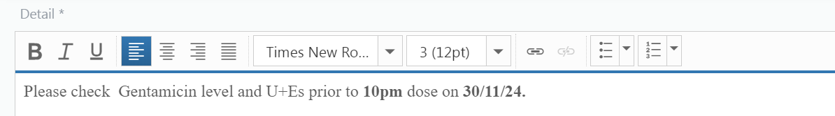
Monitoring
Reminder for prescribers and midwifery team
Take levels at the right time
Trough level <2mg/L (taken immediately pre-dose)
Peak level 7-10mg/L (taken 1-hour post-dose)
Daily U+Es
Take the first trough and peak levels on the 3rd dose, then every 3 to 5 days if renal function is stable.
NB. If the dose is adjusted based on levels recheck the levels on the 3rd NEW dose.
Add an order note on HEPMA as a prompt.
We are currently trialling a Gentamicin MONITORING chart.

Slide 16
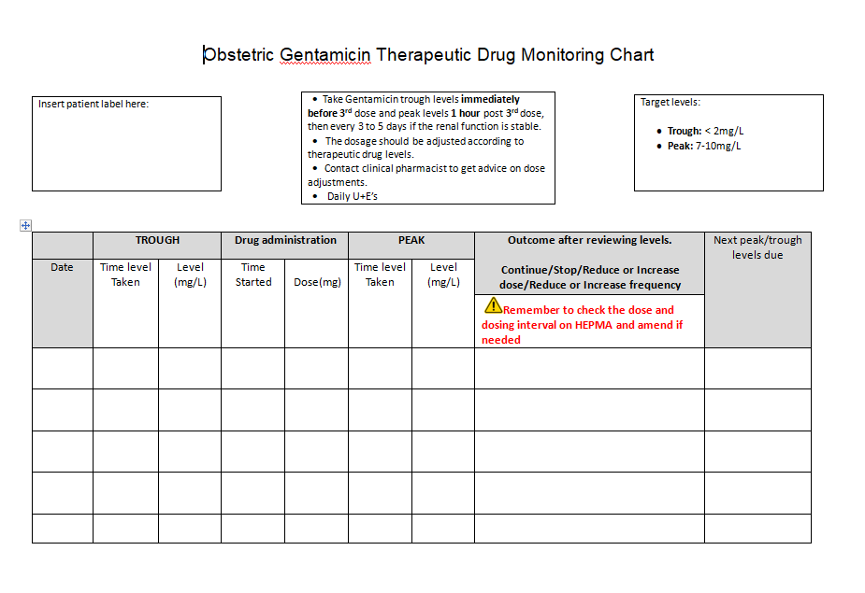

Slide 17
Ward life

Slide 18
Obstetrics wards ***Work carried in Ward 119***
One or 2 people rotated daily to cover antenatal and postnatal ward
One doctor carrying bleep #2119, other doctor on "help"
SHIFT 08:30-17:00 (handover at 16:30 to doctor carrying #4000)
08:30- 09:00- complete discharges/ quick tasks before WR
WR start at 09:00 in W119, then continues in W210.
Doctor on #2119 goes on the WR.
Doctor helping starts discharges in ward 210
Usually same consultant all week
Every ward has its own patient's sheets which midwives will provide and its own jobs book
Only certain patients flagged by MW will be seen on the WR (sometimes that can be almost the entire ward!)
LW team helps (if not too busy) by doing WR in W210.
Daily work involves tasks from WR, discharges, reviewing unwell patients
Concerns can be escalated to WR consultant or LW team (JR #1622/1628, SR #1616, cons #1617)
Discharges have templates- please check VTE score, contraception, follow up plan
MWs are trained in collecting blood and inserting PVC, but few are trained for blood cultures

Slide 19
Discharge templates
\SVD- spontaneous vaginal birth
\forceps- any assisted vaginal birth (HFFD, KRFD, Kiwi)
\ellucs- elective C-section (should be started by the assisting doctor)
\emlucs- emergency C-section
\tears- 3rd/4th degree tears
\hyperemesis
\anadm- for all antenatal admissions.
New backslash for postpartum hypertension management to be added to GP letters \gphtn

Slide 20
Labour ward #4000
DAY SHIFT FROM 08:30-21:00
Attending morning handover at 08:30
WR in LW after handover
Usually flexible until 17:00- helping on LW with tasks, assisting in theatre, helping on the obstetric wards with discharges or seeing unwell patients, helping in Obstetrics triage
Calls from the wards for help if #2119 is busy
Handover from ward team at 16:30, then covering the wards for out of hours calls- any small tasks remaining from the day, emergencies, prescribing; helping in OTA
NIGHTSHIFT FROM 20:30-09:00- OOH cover for emergencies, prescribing, assisting in theatre, reviewing patients in OTA/ LW/ obstetric wards
WEEKEND SHIFTS 08:30-21:00- covering LW/OTA/ wards
Starting at 08:30 with LW handover
Goes on WR with consultant on W119/210
Complete tasks from WR/discharges;
Can be called from OTA and LW to review patients or to assist in theatre

Slide 21
Gynaecology ward **Postnatal ward moved to W210, and Gynaecology decanted to ward 203***
SHIFT 08:30-17:00, usually one doctor, but can sometimes have an extra tier 1
Carrying bleep #4001 for the shift, then handing over bleep and patients at 16:30 to evening doctor
Morning handover at 08:30 with nighttime tier 1/ SpR, then going through ward list with day team- charge nurse presenting patients
It is helpful to have a computer at handover which can be taken on the WR
WR is done for all patients, Gynaecology SpR stays for the WR
Usually same consultant for all week
Consultant and SpR also cover PSC and GTA
After WR, duty to complete tasks and discharges in a timely manner
Most nurses are trained in cannulating and taking bloods
For advice contact Gynaecology SpR bleep #1625 or the Gynaecology consultant on mobile
Usual discharge template \idl

Slide 22
Triage shift #4001 (S/T shift on the rota)
DAYSHIFT 08:30/09:00- 21:00
Morning session can be clinics/ ward help/ theatres
At 13:00 goes to OTA to help registrar
At 16:30 receives bleep #4001 and covers Gynaecology ward for the remainder of the shift
At 18:30 doctor from GTA hands over any remaining jobs or patients to be seen in Ward 203
Handover at 20:30 in LW handover room
NIGHTSHIFT 20:30-09:00 (handover in LW room)- covers gynaecology ward and any new gynaecology admissions, helps out in OTA, assists in theatre; can be called by obstetrics ward if #4000 is busy in theatre
WEEKEND SHIFT 08:30-21:00 (handover in LW room)
Covers gynaecology ward- goes on morning WR with consultant, does tasks and discharges
Might be asked to help in obstetrics as usually busier- seeing patients in OTA, assisting in theatre, helping on the wards if #4000 is busy

Slide 23
Questions?

