Slide 1


Pain Assessment & Management in Palliative Care
5-day palliative care module

Slide 2
Objectives
Understand the process of holistic pain assessment
Discuss the complexity of pain assessment and pain management in practice – including in cognitive impairment
Evaluate the presentation and management of different types of pain
Recognise the range of options in pain management – pharmacological and non-pharmacological

Slide 3
What is pain?
“Pain is what the experiencing person says it is, and exists whenever the experiencing person says it does”
(McCaffery and Pasero 1999)
Notes:
3
3

Slide 4
Definitions of Pain
Pain is a complex, subjective and unpleasant sensory and emotional experience associated with actual or potential tissue damage.
It serves as a protective ‘alarm’ system for the body signaling harm or danger.
Notes:
4
4

Slide 5
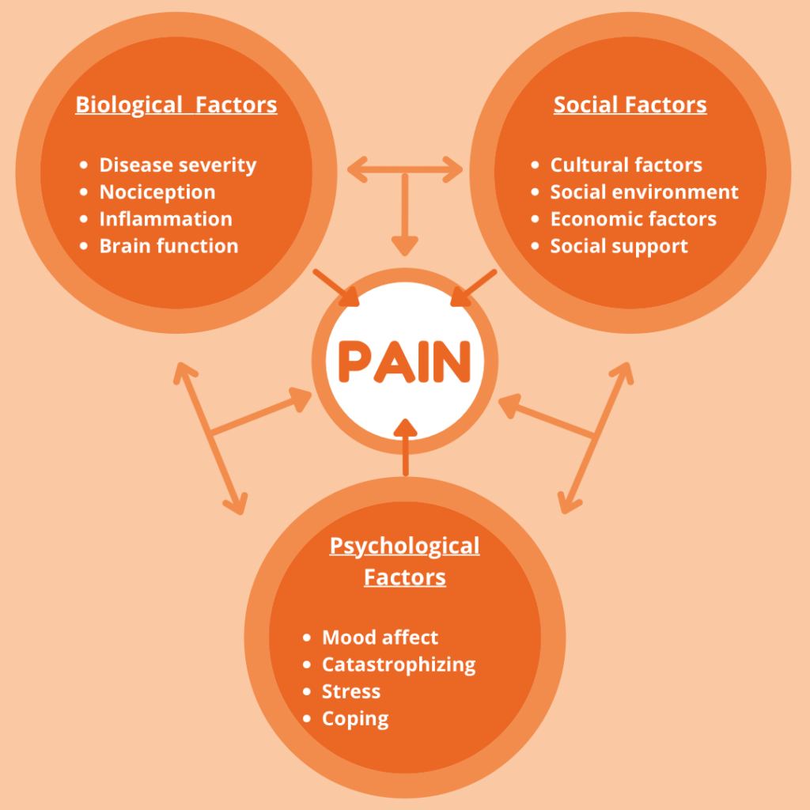
Definitions of pain
Notes:
Pain is personal, influenced by biological, psychological and social factors.
It can range from acute or chronic.
No 2 people will experience pain in the same way. Very personal and influenced by mood, past experiences and mental state.
Sometimes messages in the brain can get confused and doesn’t always understand the pain. Part of the process is linked to our emotions and therefore, if we are feeling angry, depressed or upset – this can have a knock on effect on our pain.
Sometimes we anticipate pain – we think something is going to be sore. The opposite is true – our pain is less when we feel happy.
It shows that pain is ‘never just in the mind’ or ‘just in the body’. It’s a complete mix.
Pain stimulates neuro transmitters. These can be bad. Worsened by mood. Good transmitters are stimulated by analgesia and happy times.
It is important that we do an holistic assessment to see how we feel about pain and how it affects the life of a patient.

Slide 6
Holistic assessment
Patients own description
01
Assess each pain and identify cause
02
Assessment tools
04
OPQRSTUV
03
Notes:
1 – pain is what the patient says it is (patient centred/empathy/ Dr. Margo McCaffery, a pioneer in pain management nursing.)
2. Discuss the importance of assessing each pain – may be a headache, sore stomach, constipation. May not always need an opioid.
OPQRSTUV – acroymn
Onset – when did it begin, how long does it last, how often
Provoking – palliating – What brings it on, What makes it better, what makes it worse?
Quality – what does it feel like, can you describe it, have you experienced this before
Region/radiating – where is it? Does it spread anywhere?
Severity – Using a numerical scale – how bad is it? Right now, at it’s worst, on average? How much does it bother you?
Treatment – what medications are you currently using? What helps? How does it help?
Understanding the impact – What do you believe could be causing this pain, how is affecting you, or your family? What does it interfere with?
Values – what is your goal for this symptom? What is an acceptable level of pain? Are they any other views/feelings that would be important to you?
Assessment tools – numerical scores, smiley faces, Abbey pain chart, PACSLAC, news

Slide 7
Descriptions of pain
Cramping
Tight
Gnawing
Shooting
Throbbing
Pins and needles
Achey
Burning
Numb
Sharp
Notes:
What does this tell us?
It gives us an idea of what type of pain it is and what may be causing it.

Slide 8
Types of pain
Somatic
Visceral
Neuropathic
Breakthrough and incident pain
Notes:
Somatic –from the soft tissues –such as skin, muscle, can be MSK pain. Can be deep or superficial. Described as achey, cramping, gnawing, throbbing type pain.
Visceral – a vaguer pain, poorly localised, stretching – often due to damage of the internal organs – squeezing, spasms, tight feeling, liver, bowel,
Neuropathic – from a damaged nerve/pathway
Breakthrough – just as it says, acute onset/flare up/increase in intensity on a background of controlled pain.
Incident pain – during an anticipated movement. -

Slide 9
Challenging pain assessment
In patients with cognitive impairment
Speech or language difficulties
Altered conscious levels
Different perceptions from families
‘Drug seeking’ behaviours
Notes:
What are the challenges

Slide 10
Management - SPCG
What’s next?
Holistic assessment
Reversible causes?
Pain tools?
Continuous assessment

Slide 11

Pain Management
“By using a combination of appropriate dosage guidelines and the use of the WHO pain ladder it should be possible to achieve adequate pain relief in 70-90% of patients with cancer“
Van den Beuken-van Everdingen MJ et al. Pain 2007; 137: 312-32.
Notes:
The WHO Analgesic Pain Ladder was developed by the World Health Organization (WHO) in 1986 as part of its Cancer Pain Relief program. While it was a collaborative effort by a group of experts in pain management, no single individual is officially credited with designing the ladder.

Slide 12
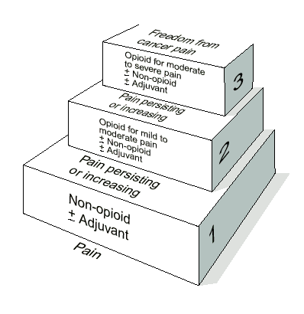
Analgesic ladder (WHO)
Notes:
Pain relief should be by the clock, by the ladder, by the mouth.
Also discuss that we are focusing on patients with cancer pain rather than chronic pain as chronic pains are managed very differently.

Slide 13
Examples of Drugs in the Ladder
STEP 1 | STEP 2 | STEP 3 | ADJUVANT
Co-Codamol 8/500 | Codeine Phosphate | Morphine IR e.g. oramorph | Amitriptyline
Paracetamol | Tramadol | Morphine MR e.g. Zomorph | Carbamazepine
Aspirin | Co-Codamol 30/500 | Morphine Sulphate | Gabapentin
Diclofenac Sodium | Dihydrocodeine | Oxcodone IR e.g. shortec capsules or oxynorm liquid | Dexamethasone
Ibuprofen | Sevodyne (Buprenorphine) | Oxycodone MR e.g. longtec
 |  | Oxynorm Diamorphine
 |  | Buprenorphine
 |  | Fentanyl
Notes:
This table provides us with an example of some of the types of drugs that are available according to the various steps of the analgesic ladder and I appreciate that these drugs are available to our patient in the UK, but may not be so easily available in other countries in the world. New formulations of opioids are being introduced in the uk regularly and the most recent additions are sub lingual fentanyl (abstral), buccal fentanyl (effentora) and intra nasal fentanyl (insantyl) all indicated for breakthrough cancer pain, but for patients already established on a background opioid.
Verbal scores which relate to appropriate step of ladder as per sign guidelines page 16

Slide 14
Adjuvants
An adjuvant analgesic is a medication that is not primarily designed to control pain but can be used for this purpose
Notes:
In the context of the WHO pain ladder and pain management, an adjuvant (or adjuvant medication) refers to:
A drug that is not primarily designed to control pain but can help enhance pain relief when used alongside analgesics (painkillers).
Examples of Adjuvants:
Antidepressants (e.g., amitriptyline) – useful for nerve pain
Anticonvulsants (e.g., gabapentin, pregabalin) – also used for neuropathic pain
Corticosteroids – reduce inflammation and swelling
Muscle relaxants – for muscle spasms
Local anesthetics (e.g., lidocaine patches)
Lidocaine, creams – menthol, chilli cream, bisphosphonates, NSAID
14

Slide 15
Adjuvants
Adjuvants are mainly unlicensed apart from gabapentin, pregabalin, duloxetine and lidocaine 5% plasters
Includes NSAIDs, antidepressants, anticonvulsants, bisphosphonates, corticosteroids, antiarrhythmics
Can use single agent or combinations
Notes:
15

Slide 16
How do painkillers work?
Injury
Chemicals produced
Activate pain signals
Notes:
When injured – chemicals released. Generally prostaglandins, substance P and bradykinins.
These chemicals activate the nociceptorrs (pain receptors)
This stimulous causes an electrical signal which goes to the brain.

Slide 17
Step 1 Analgesia – Mild Pain
Paracetamol tabs
Unknown mode of action (?inhibits prostaglandins)
Well absorbed orally with ~80% bioavailability
Reaches peak levels after 30-120mins
90% liver metabolism & renal clearance (half-life 1-4hrs)
Dose reduction if <50kg, poor nutritional status, chronic alcohol abuse, LFTs^
NSAIDS e.g. ibuprofen, naproxen, diclofenac
Analgesic + anti-inflammatory – inhibits COX1+2
Useful in bone pain, soft tissue, liver capsule pain
^ risk cardiac, renal & GI side effects (PPI)
Diclofenac can be given SC

Slide 18
Step 2 Analgesia – Moderate Pain
Codeine
Dihydrocodeine
Tramadol
Mild opioid receptor binders (agonists)
Require liver metabolism to active metabolite (e.g. codeine -> morphine)
Contraindicated in liver impairment or CKD 4-5
Max dose codeine/dhc equivalent to 24mg PO morphine/24hr
Max dose tramadol equivalent to 40mg PO morphine/24hr
Buprenorphine (3/4/7 day patch) partial agonist only
Contra-indicated in acute or unstable pain
Useful in CKD
5mcg/hr patch equivalent to 12mg PO morphine/24hr
Buprenorphine
Notes:
You have opioid receptors throughout your nervous system such a mu, delta, kappa receptors. Substances that activate these receptors are called opioid agonists. Opioid agonists are drugs such as morphine, oxy.
The body can make it’s form of opioids such as endogenous opioids.

Slide 19
Step 3 Analgesia (Opioids) – Severe Pain
Use dates back to 3rd Century BC
Opioid analgesia derived from Opium
Greeks dedicated the opium flower to the Gods of:
Death (Thanatos)
Sleep (Hypnos)
Dreams (Morpheus)
PO/SC: Morphine, Oxycodone
SC/Sublingual/Buccal: Alfentanil
Transdermal/Sublingual/Buccal/nasal: Fentanyl
Can cause n+v, constipation, dry mouth, hallucinations, anorexia, respiratory depression
Can also be used in low doses for SOB

Slide 20

Opioids
Double check: name, strength, formulation, dose, route
Oral opioids formulated in Immediate release (IR) or Modified release (MR) preparations
MR – slow onset, long half-life. Useful for background pain e.g. Zomorph, MST, Oxypro. Caution: some are 24hrly Vs 12hrly
IR – quick onset, short half-life. Useful for breakthrough pain or regular low doses if appropriate (elderly, SOB) e.g. Oramorph, Actimorph, Shortec
Buccal/Sublingual/Intranasal opioids e.g. Abstral, Pecfent
Rapid onset 5-10min. Useful for movement, painful personal care if already on opioids
Max 4 doses in 24hrs (then titrate strength)
Naloxone reversal agent – only if RR <12 if end of life

Slide 21
Choosing or Changing an Opioid
Consider:
Available route/strength
Renal + liver function
Is pain stable?
Potency & approx. equivalent dose, HOWEVER usually reduce by ~33%
30mg Morphine PO
15mg Oxycodone PO
1mg Alfentanil SC
12mcg/hr Fentanyl patch
15mg Morphine SC
7.5mg Oxycodone SC

Slide 22

Side effects of opioids
Benefits
Side effects/
toxicities

Slide 23
Patches
Lidocaine plaster
Useful for rib fractures, neuropathic pain
12hrs on followed by 12hr patch-free period to avoid tolerance
3% systemic absorption, well tolerated but caution in severe heart disease
Trial of 2 weeks
Fentanyl & buprenorphine patches
Useful in stable pain
Continue if patient commenced on CSCI
Takes 12hrs to work – give alternative analgesia
“Transdermal patch check” on Hepma
Apply to intact, non-hairy skin on the upper trunk or upper arm + rotate site
Heat can ^ absorption
To dispose: fold in half then sharps box, wash hands

Slide 24
Adjuvant analgesic ladder neuropathic pain
AFTER FAILED
OPIOID+NSAID
Spinal
analgesia
NMDA
blockade
STEP 5
Tricyclic
antidepressant
& anticonvulsant
STEP 4
Tricyclic
antidepressant
or anticonvulsant
STEP 3
Corticosteroid
STEP 2
STEP 1
Notes:
There are many adjuvants about – some licensed and some with more evidence than others
This a suggested ladder [Twycross]
Steroids certainly whenever motor weakness or likelihood of compression – usually dexamethasone.
TCA – eg Amitriptyline,noratriptyline gabapentin, pregabalin, duloxetine, carbamazepine, sodium valporate
Lidocaine plasters, ketamine (NMDA –N-Methyl D Asparate receptors blockade)

Slide 25
When to use the SC route?
Persistent nausea and vomiting
Dysphagia: intermittent or continuous
Profound weakness
Unacceptable number of oral medications
Reduced level of consciousness
Intestinal obstruction
Malabsorption or suspected malabsorption of oral medication
Severe stomatitis
Head and neck surgery/disease
Terminal restlessness and agitation
Patient choice
Notes:
last Bullet point
Patient may feel reluctant to come off pump if they have been well symptom controlled on this. Previous oral control may have been poor

Slide 26
Common Drugs Used via SC route
Opiates – Morphine, Oxycodone, Alfentanil
Antiemetics – Cyclizine, Metoclopramide, Haloperidol, Levomepromazine
Anxiolytics - Midazolam
Anti-inflammatories – Seek advice
Neuropathic drugs – Seek advice
Anti- secretory drugs – Hyoscine Butylbromide
Anti-convulsants
Others – e.g. Octreotide, methadone
Notes:
Be aware of the spelling of Alfentanil - with an I not a Y. They are 2 completely different drugs
Fentanyl which in pc is normally used in patch formulations. Exceptional circumstances that we would use injection form
Fentanyl injection is 4 x stronger than Alfentanil injection

Slide 27
Practical advice for analgesia
Breakthrough dose should be 1/6th to 1/10th 24hour dose requirement. Review if uses 6/24hr or 3 in 4hrs
Double check fentanyl + alfentanil
Fentanyl patch can be left on if CSCI started
Hot baths, temp >39
Prescribe Transdermal patch check on HEPMA
Dexamethasone SC as e.g. 4mg or 8mg and add note for volume (3.3mg/ml)
You can prescribe BM check for patients on steroids on HEPMA
Max 2ml SC
Treating anxiety can reduce opioid requirements
Consider fentanyl SL/Buccal for short-lasting incident pain e.g. bone mets
Monitor side effects – laxatives, anti-emetics, mouthcare.

Slide 28
Non-pharmacology
Complimentary therapy
Relaxation
Acupuncture
TENS machine
Be aware of concept of total pain
Notes:
Any others - positioning

Slide 29
One Man's Medicine. [Cochrane AL (with M Blythe). London: BMJ (Memoir Club), 1989, p 82.]
"Another event at Elsterhorst had a marked effect on me.
The Germans dumped a young Soviet prisoner in my ward late one night.
The ward was full, so I put him in my room as he was moribund and screaming and I did not want to wake the ward.
I examined him. He had obvious gross bilateral cavitation and a severe pleural rub. I thought the latter was the cause of the pain and the screaming. I had no morphia, just aspirin, which had no effect.
I felt desperate.
I knew very little Russian then and there was no one in the ward who did. I finally instinctively sat down on the bed and took him in my arms, and the screaming stopped almost at once. He died peacefully in my arms a few hours later. It was not the pleurisy that caused the screaming but loneliness. It was a wonderful education about the care of the dying.
I was ashamed of my misdiagnosis and kept the story secret."
Notes:
29

Slide 30
ANY QUESTIONS?
Notes:
30
30

